Slide 1
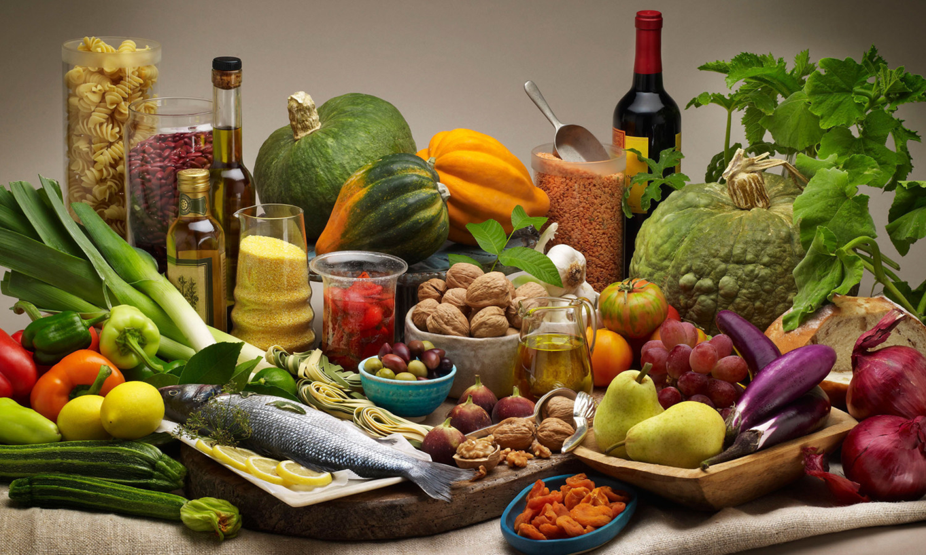
Diet Makes a Difference

Slide 2
Food and Climate Change
Know how your food affects both your health and your environment.
Climate change is affecting the way that people produce and consume food.
A diet which causes less environmental damage is also better for health

Slide 3
Livestock Production
Growing livestock is far less efficient than producing plant-based foodstuff
It requires approximately 5-7 kilograms of grain to produce one kilogram of beef
Beef is the least resource-efficient of all livestock production and the most damaging to the environment

Slide 4
Beef Production
Beef production contributes to approximately 9% of all emissions attributable to human activity and 65% of all livestock emissions in the United States.
Cattle feed requires more water than any other agricultural product, and the nitrogen-containing fertilizer used to grow it is a major source of water pollution.
Raising cattle produces methane, a far more potent greenhouse gas, and contributes additional carbon dioxide emissions because of the energy required to provide feed using modern industrial food systems.
Beef production promotes deforestation.
Source: Eshel G, Shepon A, Makov T, Milo R. Land, irrigation water, greenhouse gas, and reactive nitrogen burdens of meat, eggs, and dairy production in the United States. Proc Natl Acad Sci USA. 2014;111(33):11996-12001.

Slide 5
Meat Diet and Methane Pollution (Methane has 70 times the warming power of CO2 )
Notes:
In addition to its nutritional impact on our health, the emissions from production add to global warming, which has further health impacts on food and water. second largest source of methane are animals we raise for meat and dairy, with each cow producing over 1000 liters/d. The third is decay of wasted food in landfills

Slide 6
Food, Agriculture, and Your Health

Slide 7
New USDA Dietary Guidelines
Strong evidence has shown that diets with lower intake of meat are associated with reduced risk of cardiovascular disease (CVD)
Moderate evidence indicates that lower meat intake is associated with reduced risk of obesity, type 2 diabetes, and some types of cancer in adults
Average intakes of meats, poultry, and eggs for teen boys and adult men are above current recommendations
The recommendation for the meats, poultry, and eggs subgroup in the Healthy U.S.-Style Eating Pattern at the 2,000-calorie level is 26 ounce-equivalents per week
Source: U.S. Department of Health and Human Services and U.S. Department of Agriculture. 2015 – 2020 Dietary Guidelines for Americans. 8th Edition. December 2015. Available athttp://health.gov/dietaryguidelines/2015/guidelines/.

Slide 8
The Evidence on Red Meat
NIH-AARP Study: 20-50% increased mortality from cancer and CVD (Sinha, 2009)
Women's Health Study: 28% more incidence of diabetes (DM) over 8 years (Song, 2004)
Nurses' Health Study/ Health Professionals Follow-up Study: 13% increase in mortality per serving (all cause, cancer, and CVD). (Pan, 2012)
Extra daily half serving of meat raised risk of DM 48% for subsequent 4 years (Pan, 2013)]
Notes:
Prospective studies show that high consumption of red meat significantly increases risk of new onset DM and deaths from cancer, CVD controlling for other risk factors.

Slide 9
INTERVENTION STUDIES
Mediterranean Diet: emphasizes eating primarily plant-based foods, such as fruits and vegetables, whole grains, legumes and nuts, and limiting red meat to no more than a few times a month
60% decrease in cardiac events (Ornish, 1998)
70% decrease in CVD mortality (DeLogeri, 1994)
35- 48% decrease in metabolic syndrome (Esposito, 2004; Azadhbakt, 2005)
Notes:
Even if you already have a chronic disease, its not too late Vegetables and fruit can save you. We don't have a drug that comes anywhere close to being this effective. .

Slide 10
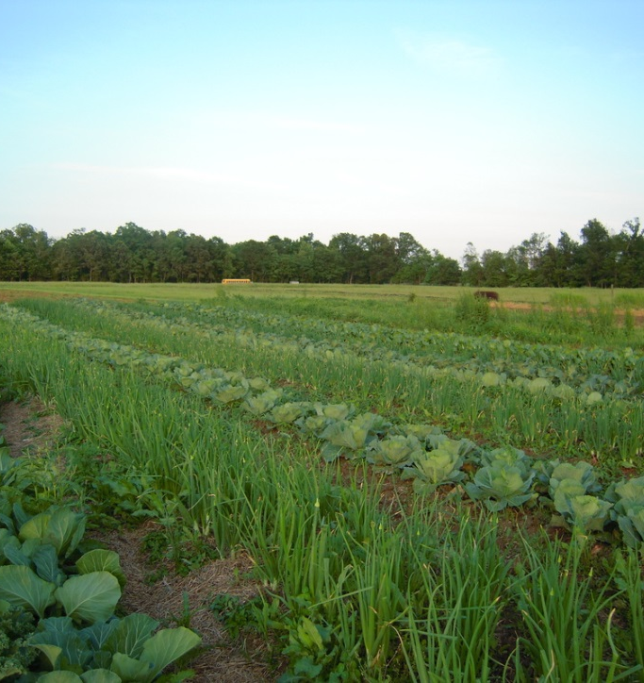
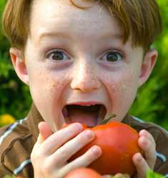
HEALTHY FOOD SYSTEM
Currently, the average meal travels 1200 km from the farm to plate. Local healthy food is grown closer to home, causing fewer transportation emissions; it is also fresher. The amount of energy needed for processing and refrigeration is reduced as the distance food travels decreases.
Notes:
‹#›
‹#›
What would we like our food system to look like?
Change how we grow

Slide 11
What you can do!
Limit red meat consumption
Eat local food whenever possible
Don’t waste food:
Nearly half of all food produced is discarded. When food is wasted, all the resources to grow, ship, package and produce it are wasted, too, including massive amounts of water.
Composting reduces methane emissions produced by landfills
Consider growing your own food
Growing vegetables at home eliminates some of the transport required to get food to your table.
Contact your elected officials to tell them about climate change!

Slide 12
Healthy diets for people and the environment

