Slide 1

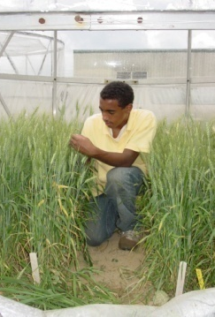

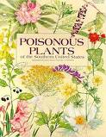
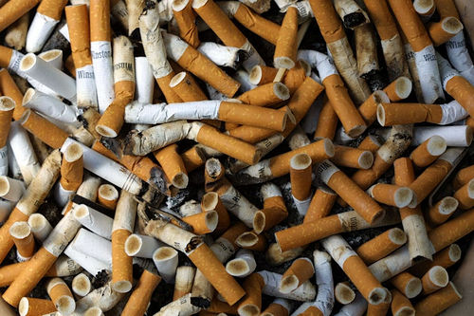
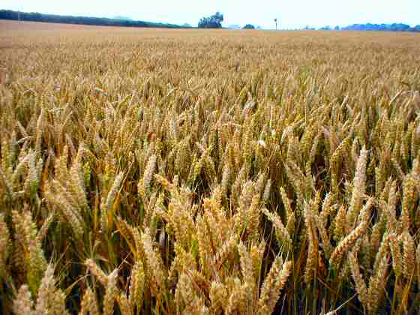
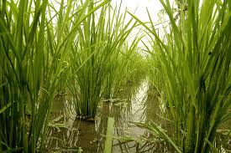
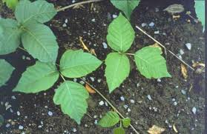


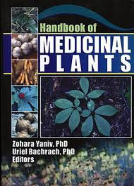

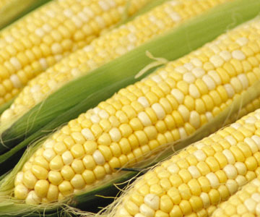

Climate Change, CO₂ and Plant Biology:
The rest of the story
Virginia Clinicians for Climate Action.
April 23, 2017
Lewis H. Ziska,PhD, USDA-ARS, Crop Systems and Global Change Laboratory
Notes:
To do justice to this issue would require a year long course. I will only hit the highlights, but hope that I can whet your appetite sufficiently that you will begin to address the issue of climate and food, not as a polemic, but as an issue of global well-being and food security.

Slide 2

An indirect effect of rising carbon dioxide: warmer temperatures.
Gas | %
Nitrogen (N2) | 78.1
Oxygen (O2) | 20.1
Argon (Ar) | 0.93
Carbon Dioxide (CO2) | 0.04 up to 0.100
Water (H2O) | 0.05 to 1.00
No H2O and CO2? Surface temperature would be –18ºC. With H2O and CO2?
Surface temperature is 15ºC.
Notes:
Carbon dioxide absorbs heat leaving the earth’s atmosphere. The more you put in the atmosphere, the more heat is trapped. This is a simple physical explanation of global warming.

Slide 3


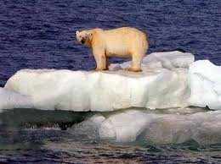



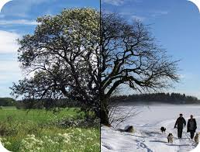
Temperature increase is not uniform
If water vapor is high, it will be the dominant warming gas….little effect of CO2
If water vapor is low, adding CO2 will increase the surface temperature. Differential rate of warming may drive extreme events.

Slide 4


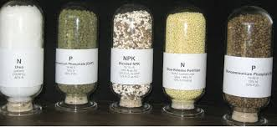
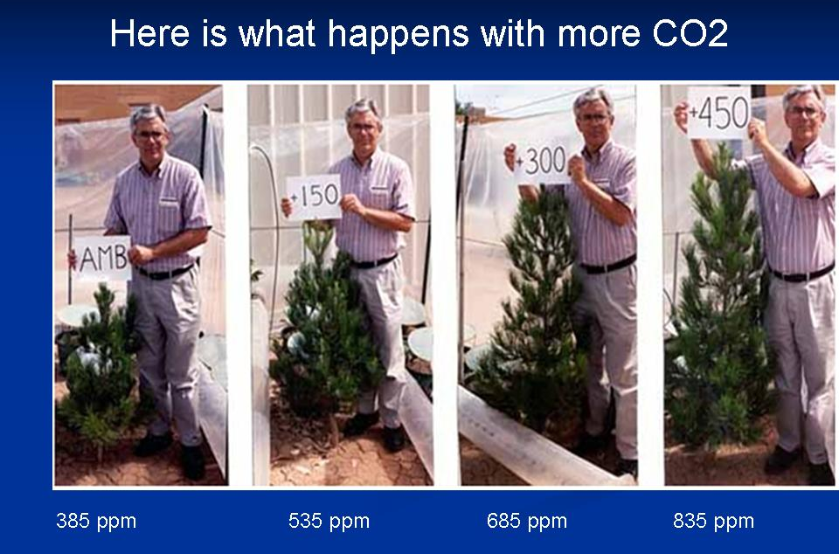

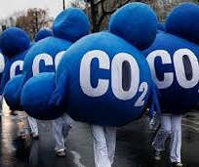
Plants are essential to life.
Light
Nutrients
Water
Carbon Dioxide
The rapid increase in atmospheric CO2 will alter global plant biology.

Slide 5
CO2, climate, plants and public health
Direct Effects
Allergies
Contact dermatitis
Toxicology
Indirect Effects
Food Supply
Nutrition
Food Safety
Medicine / Narcotics
Increased pesticide use.
Notes:
Although there are a large number of implications for biology, let us focus for a moment on those biological aspects related to public health. Among these, food supply is the most critical.

Slide 6
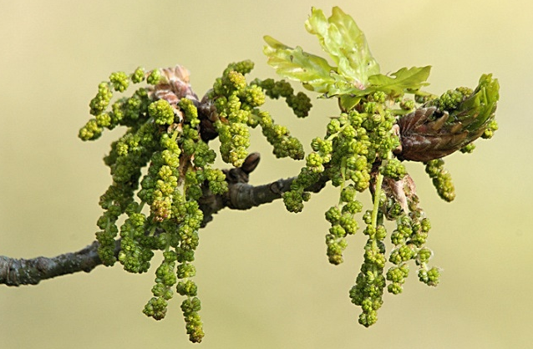
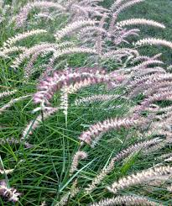
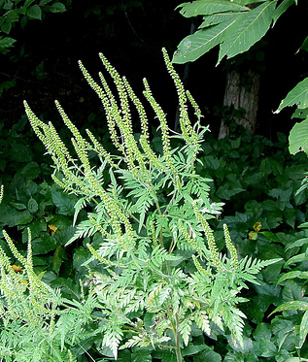

Plant-based Allergies.
Weeds and Grasses
Ragweed
Trees

Slide 7
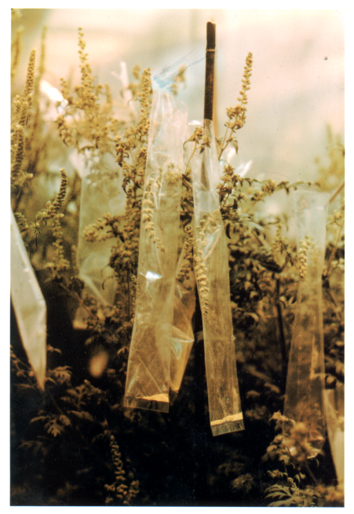
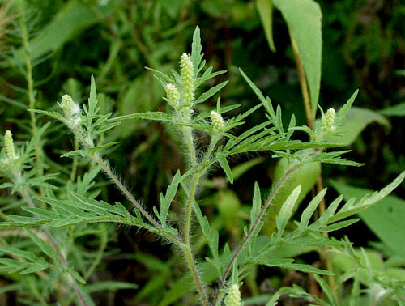
Determining Ragweed Pollen Production
Sampling pollen from ragweed catkins.

Slide 8
Response of common ragweed to CO₂
g plant⁻¹
Pollen Production
280 ppm 4.8 g
370 ppm 10.9 g*
600 ppm 20.5 g*
Antigen Amb a1 ELISA / mg protein
280 ppm 4490
370 ppm 5290
600 ppm 8180*
Chamber Study, USDA
Functional Plant Biology 27:893-898
Functional Plant Biology 32:667-670
280
370
600

Slide 9
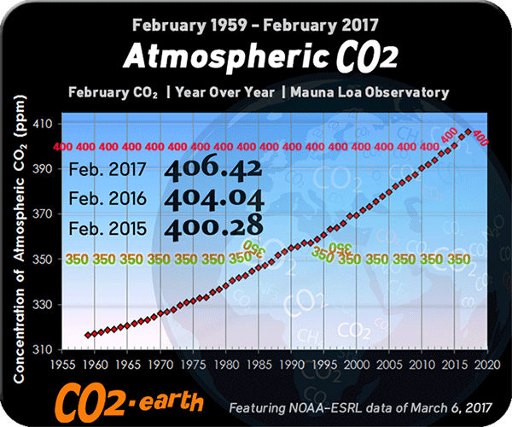

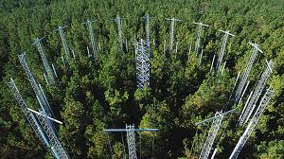
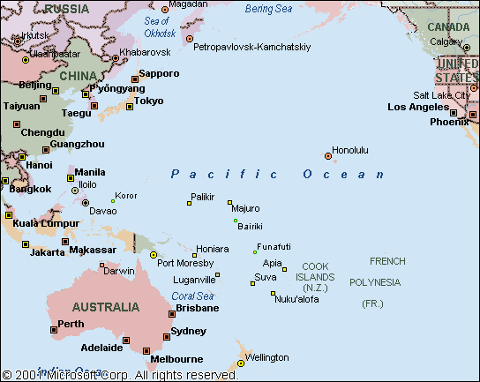

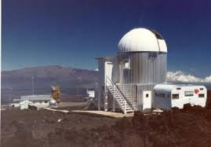

From the lab to the “real world”

Slide 10
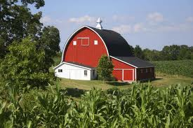


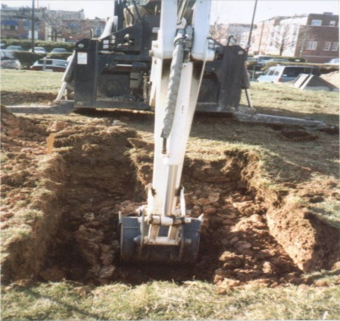

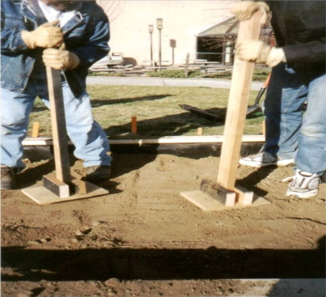
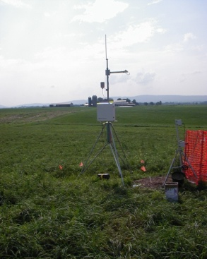
Ragweed in “real” time.
Using macro-climatic differences in CO2 and temperature along an urban-rural
gradient to study initial growth, productivity and species dynamics of fallow farm soil
(ecosystem component = secondary succession).
For each site:
ºC
CO2
1. Dig Plots 2. Move soil 3. Make uniform 4. Monitor
Notes:
Relevance to current conditions. The use of urban areas as a surrogate for climate change.

Slide 11
Urbanization and climate change.
What about other meteorological variables?
8-h daytime ozone.
2004 season
Overall: Urban-induced increases in carbon dioxide, air
temperature and growing season are consistent with most IPCC
near-term scenarios. With the exception of N deposition, other
variables did not differ consistency, but N low relative to soil N.

Slide 12


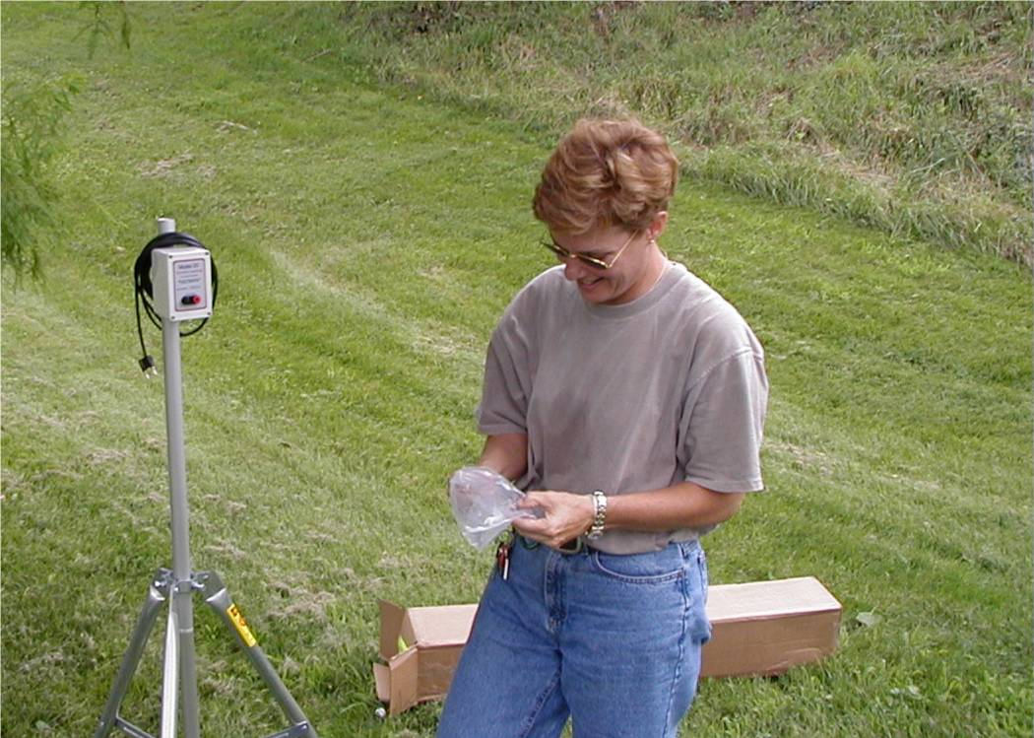
Can we study the effects of climate change NOW?
Placing four 2x2 m2 plots
Near downtown Baltimore.
Use same soil and seed bank
in suburban and rural locations.

Slide 13
Got ragweed?
2006
Urban locale had longer growing season (milder winter), warmer
temperatures, and more carbon dioxide.
Ziska et al. 2003, JACI, 111:290-295.

Slide 14
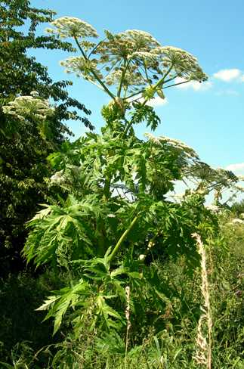
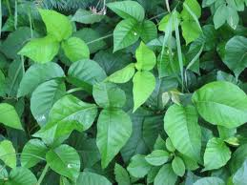


2. CO₂, plants and contact dermatitis
Can rising CO2 alter plant based dermatitis?

Slide 15
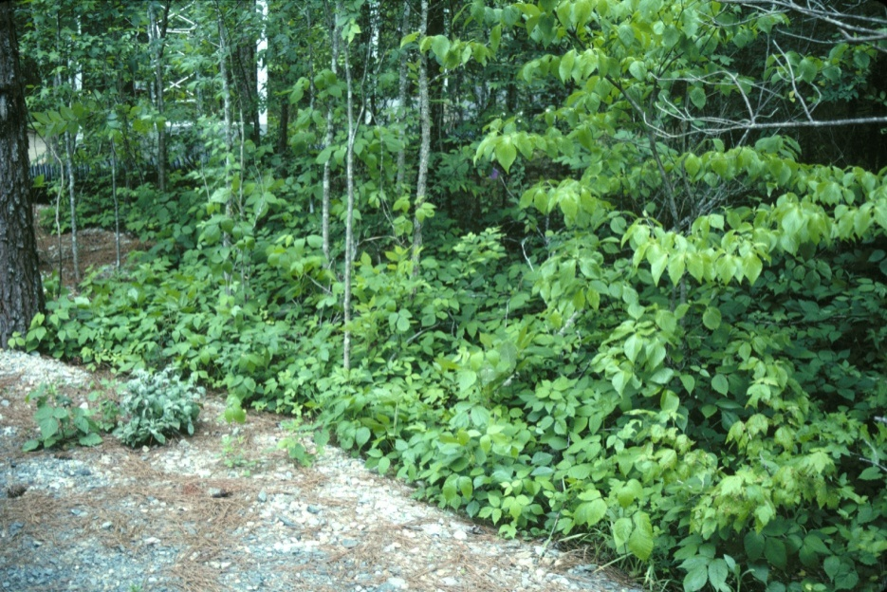
The Duke University FACE Site: State of the Art.
Poison Ivy and CO2

Slide 16
Poison ivy plants grow faster at elevated CO₂

Slide 17
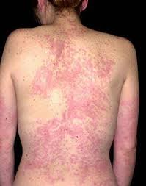
Poison ivy allergenicity
Ambient
Elevated
Duke University, USDA study,
PNAS 103:9086-9089

Slide 18
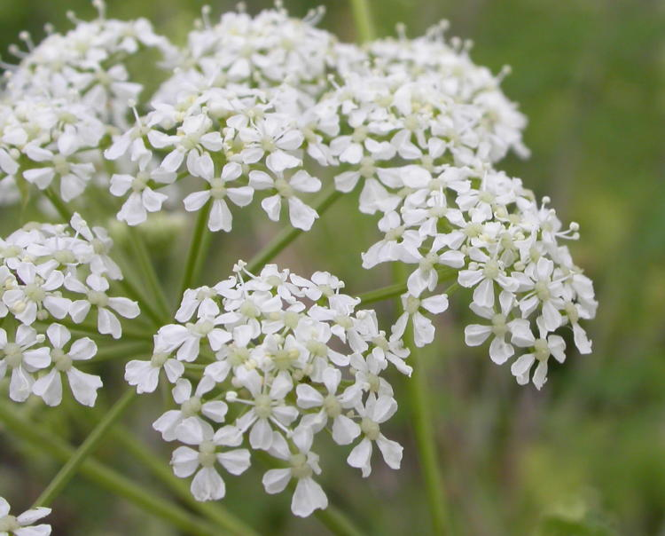

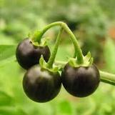
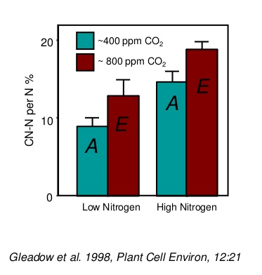
3. CO₂, plants and poison
Plants produce the most toxic substances known to man.
The impact of changing climate/CO2 on those substances
is almost entirely unknown.
CO2 allocates more nitrogen to cyanogenic glycosides

Slide 19
CO2, climate, plants and public health
Direct Effects
Allergies: CO2 and changing season length has, and will likely continue to exacerbate plant based aero-allergens.
Contact dermatitis: CO2 can stimulate the growth of poison ivy and can alter its chemistry to make a more virulent form of urushiol, the oil that causes contact dermatitis.
Toxicology: ??
Notes:
Although there are a large number of implications for biology, let us focus for a moment on those biological aspects related to public health. Among these, food supply is the most critical.

Slide 20
CO2, climate, plants and public health
Indirect Effects
Food Supply
Nutrition
Food Safety
Medicine / Narcotics
Spread of disease vectors
Increased pesticide use
Notes:
Although there are a large number of implications for biology, let us focus for a moment on those biological aspects related to public health. Among these, food supply is the most critical.

Slide 21



Food Security.
McDonalds buys 3.4 Billion pounds of potatoes
per year
Crop monocultures do not have sufficient genotypic diversity to adapt to in-season extremes.

Slide 22
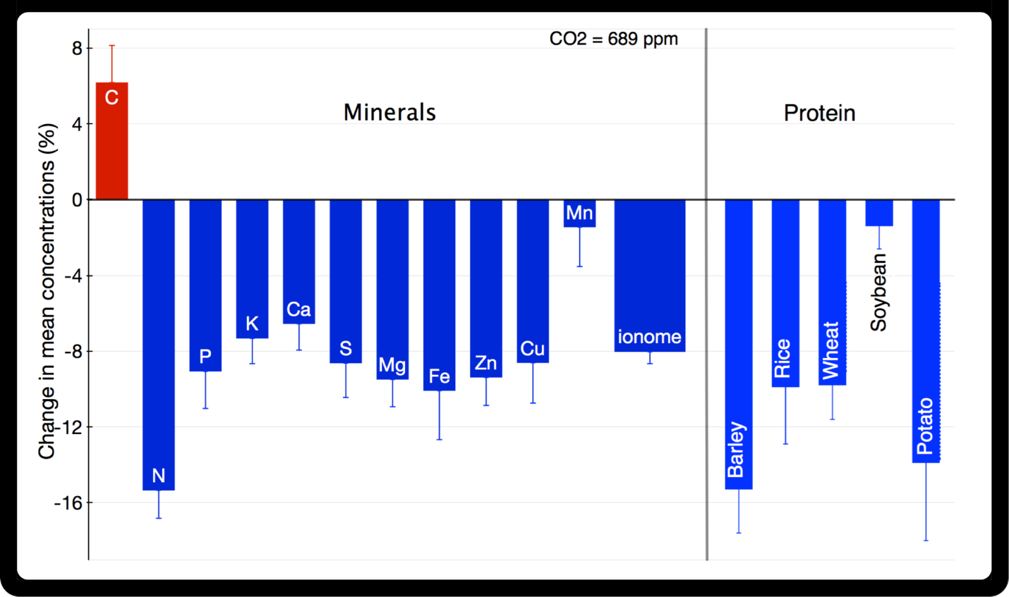
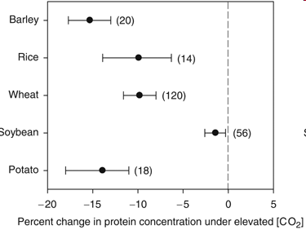
Nutritional Effects
Rising CO2 by itself will have negative effects on nutrition.
www.scidev.net/en/opinions/the-hidden-hunger-caused-by-climate-change.html

Slide 23
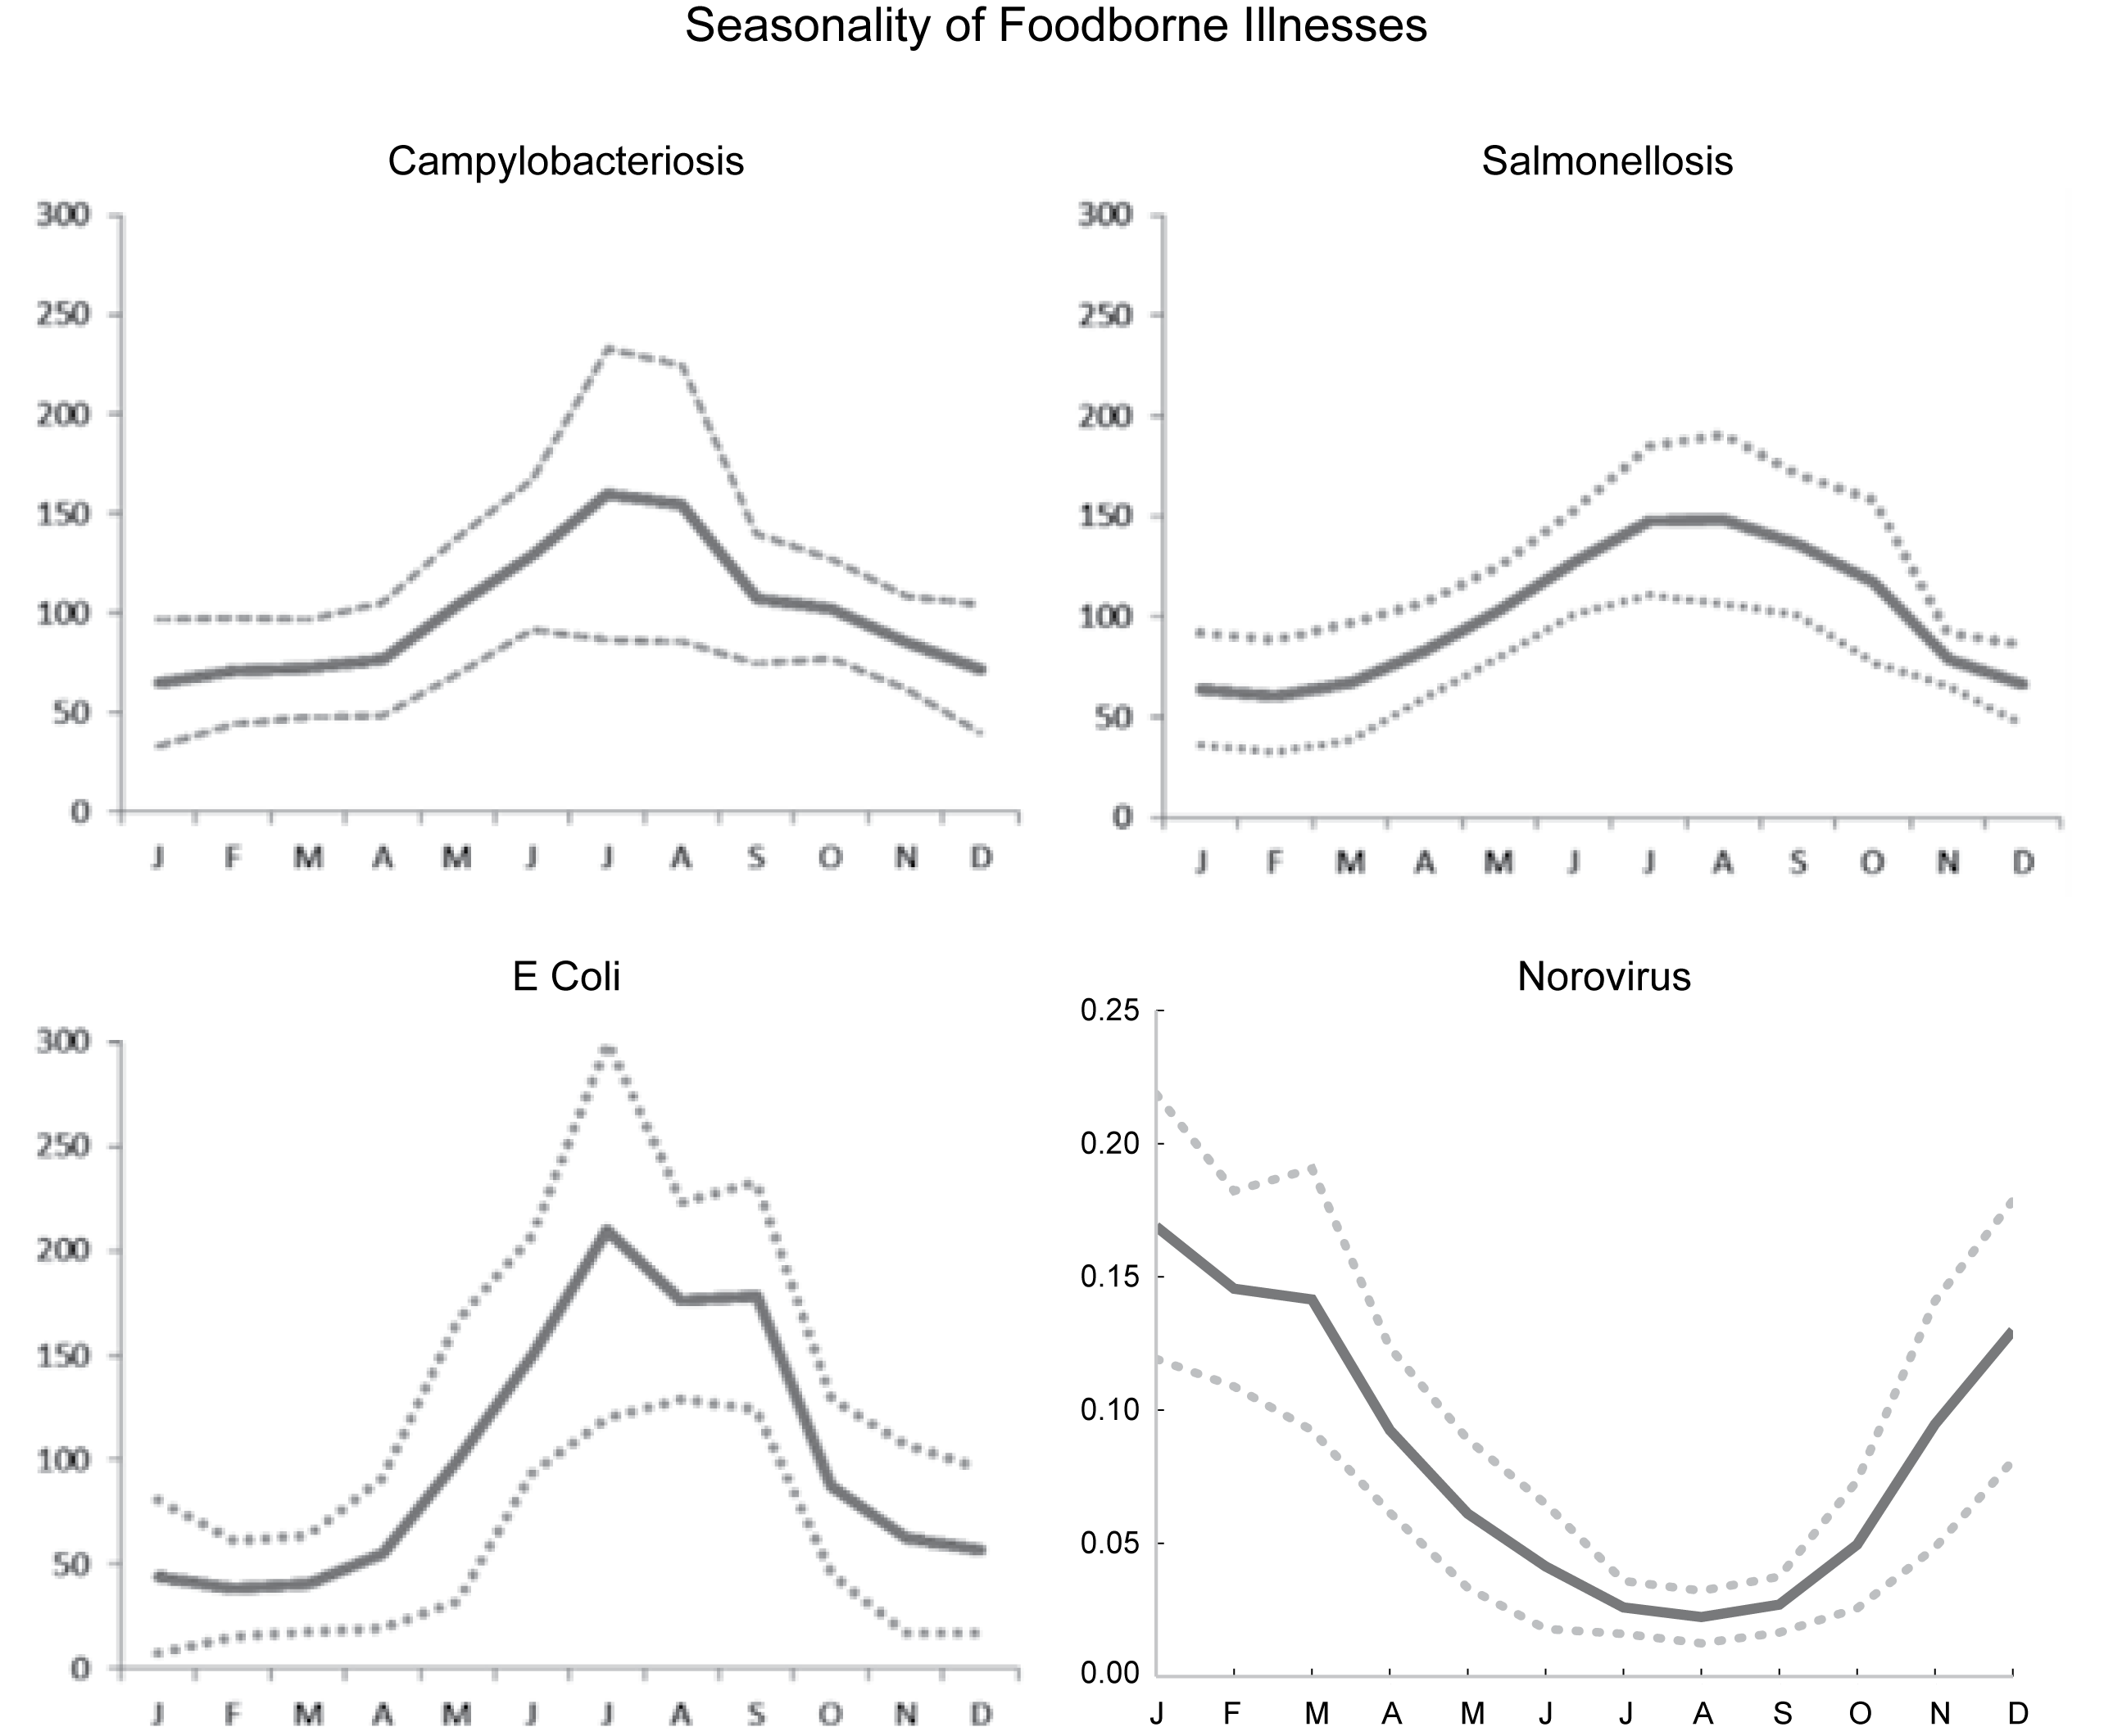
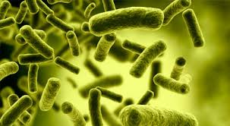
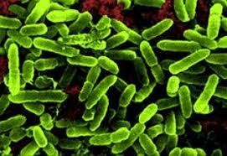
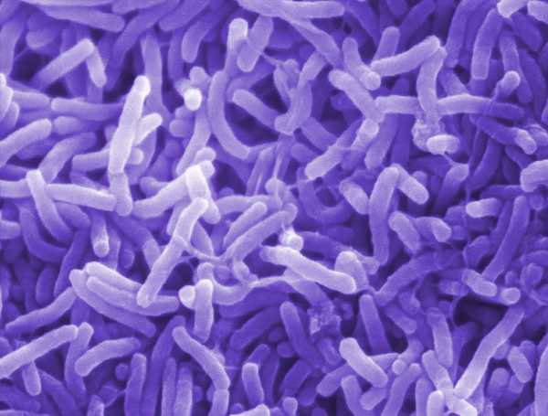
Indirect: Food Safety and Climate Change.
Salmonella
E. coli
Vibrio

Slide 24

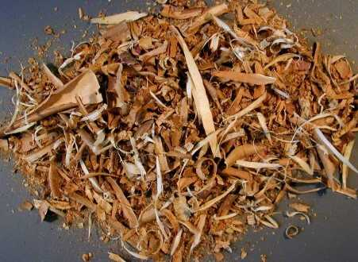

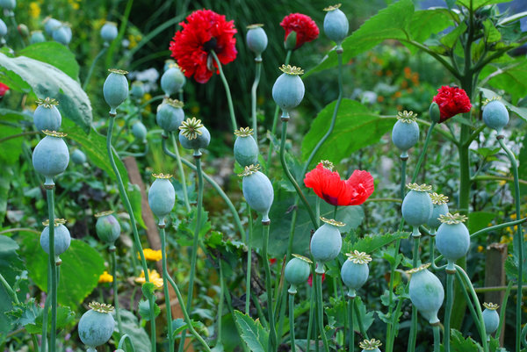
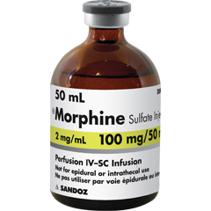
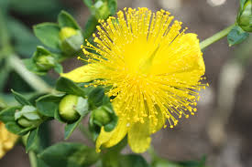

Increasing atmospheric CO₂, plant biology and medicine.

Slide 25
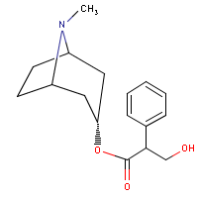
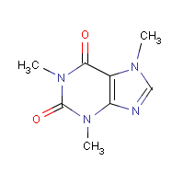
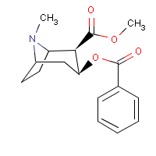
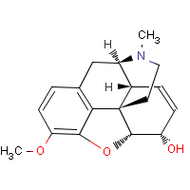

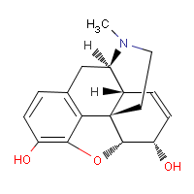
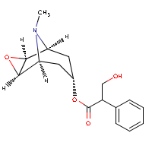

Alkaloids derived from plants
Cocaine
Atropine
Caffeine
Codeine
Nicotine
Morphine
Scopolamine
Thebaine

Slide 26






4b. CO₂, plants and narcotics.
Effects unknown
Growth Increases
Anecdotal Evidence

Slide 27




CO₂ and a Medicine/Narcotic.
Morphine
Used wild poppy (P. setigerum) as a test case.
Heroin

Slide 28

Averages P-value
Variable 300 400 500 600 CO2 Effect
____________________________________________________________
Capsule No. 14.6 29.4 32.9 52.1 ***
Capsule Wt. (g) 1.44 2.47 3.55 4.30 ***
Latex (mg) 97 198 259 363 ***
Morphine (%) 2.20 2.34 2.56 2.67 0.06
Concentration of other alkaloids did not increase with increasing CO2.

Slide 29

Plants, CO2 / Climate and pesticide usage.
Glyphosate (Roundup) is the
Most proscribed herbicide,
180,000,000 pounds annually
Notes:
Figure 1.7 Estimated annual usage of glyphosate, the most frequently used herbicide in the United States, (From 2002, USGS pesticide use maps).

Slide 30


Climate Change and Pesticide Usage.
How will rising temperatures affect pest pressures?
State | Soybean (Ha *1000) | Soybean (MT Ha⁻¹) | T_{min} (ºC)
Minnesota | 2,513 | 2.81 | -28.6
Wisconsin | 628 | 2.91 | -26.6
Iowa | 3,741 | 3.20 | -23.9
Missouri | 2,247 | 2.52 | -17.6
Arkansas | 1,308 | 2.62 | -10.9
Mississippi | 806 | 2.77 | -8.2
Louisiana | 449 | 2.81 | -5.1
Average soybean yields don’t seem to change
Even thought there is a big difference in minimal
Temperatures. Are pest pressures really changing?

Slide 31
Does Pesticide use change?
Likely that pesticide exposure will increase with warming temperatures, but health impacts
will depend on a number of additional factors such as Age, genetics, health care access, etc.

Slide 32
Climate change, plants and public health
Indirect Effects
Food Supply
Nutrition
Food Safety
Medicine / Narcotics
Increased pesticide use.
Notes:
Although there are a large number of implications for biology, let us focus for a moment on those biological aspects related to public health. Among these, food supply is the most critical.

Slide 33

Now What?
We acknowledge the synergy between plant biology, carbon dioxide, climate and public health.
At USDA-ARS, Our entire budget has declined by 25% since 2003.
Yet, potential for basic and applied research and impact of potential research in the context of public health is enormous.
What can we do to work together?
WHAT ELSE? WHAT DO YOU THINK?

