Slide 1
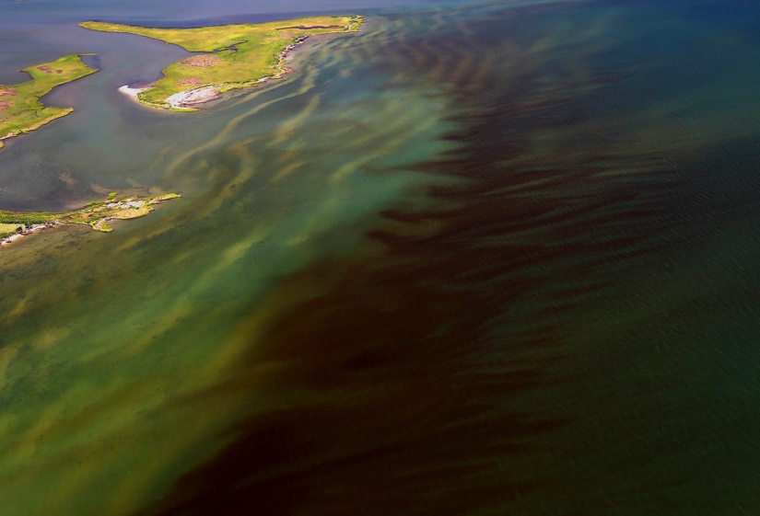
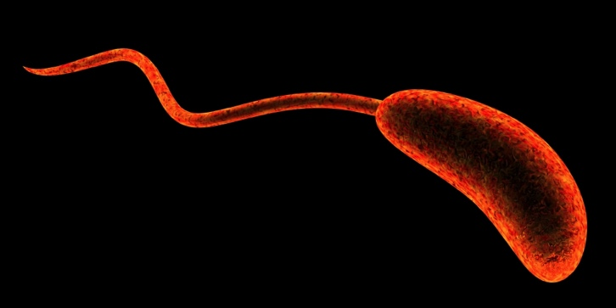
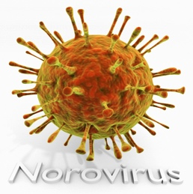
Climate Change, the Aquatic Environment and Human Health
Kimberly S. Reece, Ph.D.
Aquatic Health Sciences
http://www.foodpoisonjournal.com/files/2015/08/vibrio-flagella1.jpg
Photo by W. Vogelbein

Slide 2
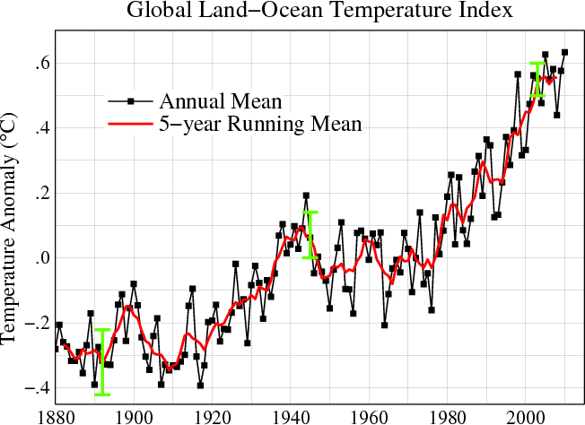
The Changing Waters

Slide 3
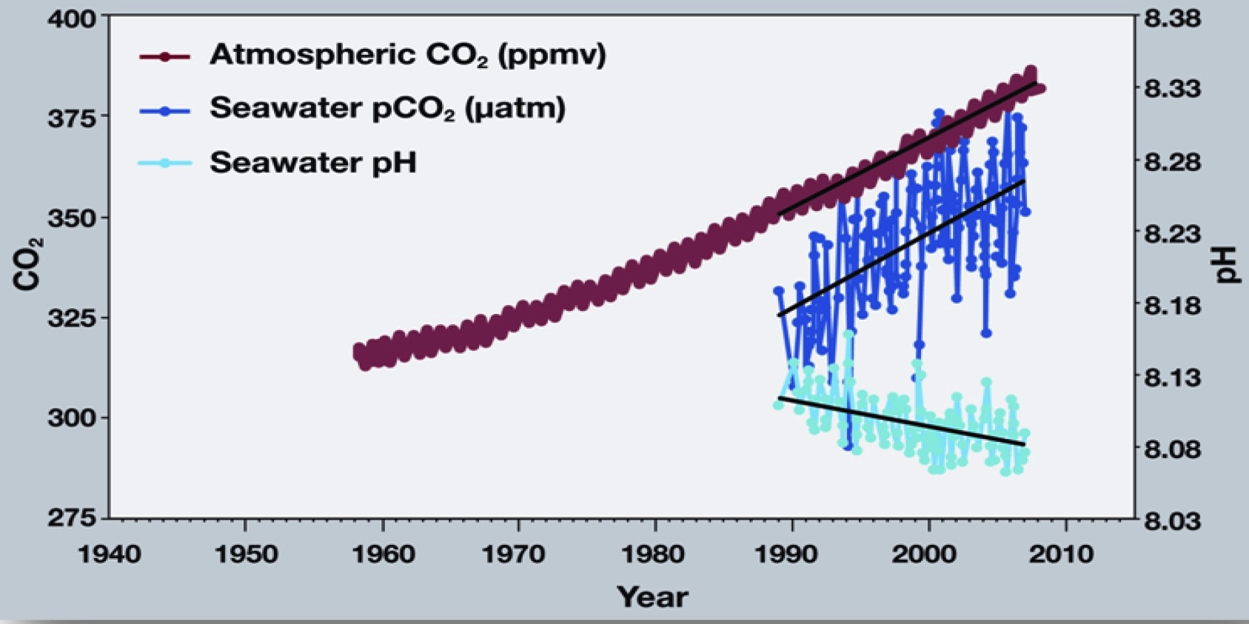
The Changing Waters

Slide 4
Shifting Patterns?
Human pathogenic Vibrio species
Human enteric bacteria and viruses
Harmful algal blooms (HABs) and associated toxins

Slide 5

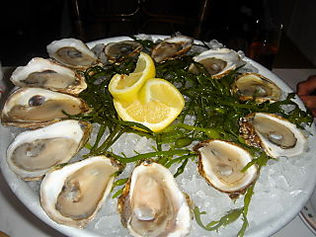


Routes of HAB Toxins and Pathogen Exposure to Humans
Humans can be exposed to pathogens and toxins directly through contact with the water-swimming, boating etc.
Often ingested through consumption of fish or shellfish.

Slide 6
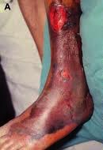
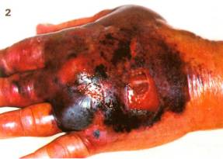
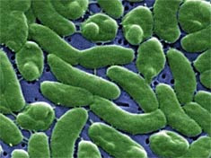
Vibrio vulnificus
Gram-negative naturally occurring halophilic (salt-loving) bacterium (lives/grows in estuarine and marine waters)
Causes wound infections, gastroenteritis and acute septicemia
Consumption of raw oysters during summer/fall represents most of the food-borne infections with V. vulnificus.
Onset 12 hrs - 3 days, death can occur rapidly
Higher densities during warmer months, positive correlation with temperature
Densities lower in higher salinity
textbookofbacteriology.net
Highest mortality rate of seafood borne illness
www.extension.org

Slide 7

Vibrio parahaemolyticus
Gastrointestinal illness normally after ingestion of raw or undercooked seafood
Estimated 4500 cases/year in the US (CDC) with 2,800 from raw oyster consumption
Generally a milder illness than V. vulnificus
This has been a common problem for the US Gulf and West coasts in the summer, and more recently, for the Northeast and Mid-Atlantic regions of the US, including Virginia
Most common seafood borne illness

Slide 8
Vibriosis in the US
Incidence of Vibrio infection was 43% higher in 2012 compared with 2006–2008.
2013 large East Coast outbreak of V. parahaemolyticus strain in the pandemic CC3 complex (serotypes O4:K12 & O4:Kunknown)
Vibriosis

Slide 9
Temperature and Salinity Influence on Vibrio spp. levels in Virginia Oysters

Slide 10
2014 Vibrio Infections

Slide 11
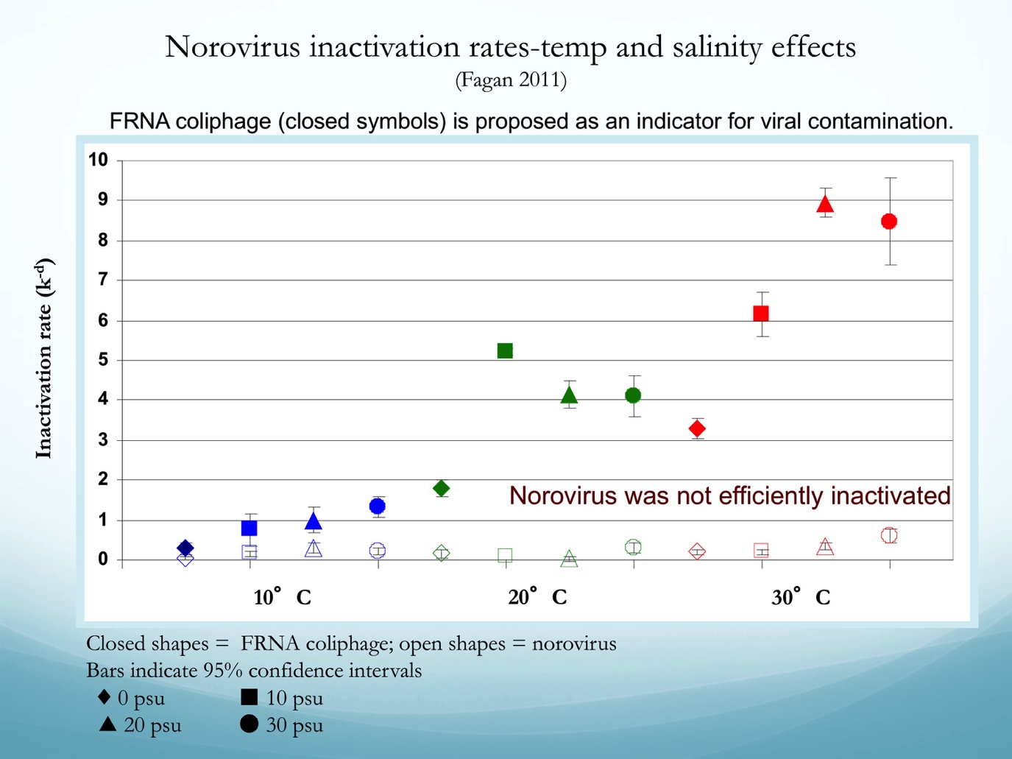
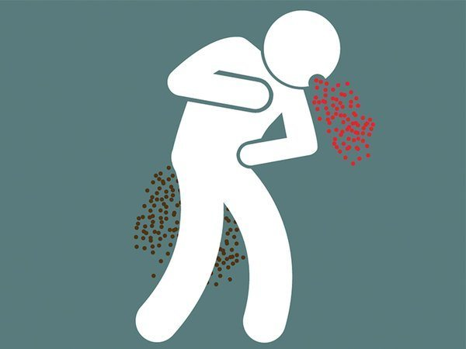
Enteric Pathogens - origin = fecal contamination
Warming waters may favor persistence of bacterial pathogens
Impact of lower pH and higher temp is not clear
Lower pH could favor viral infectivity

Slide 12
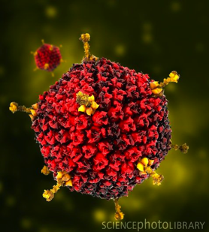
Adenoviruses: temperature and salinity persistence study (Quidort 2013)

Slide 13
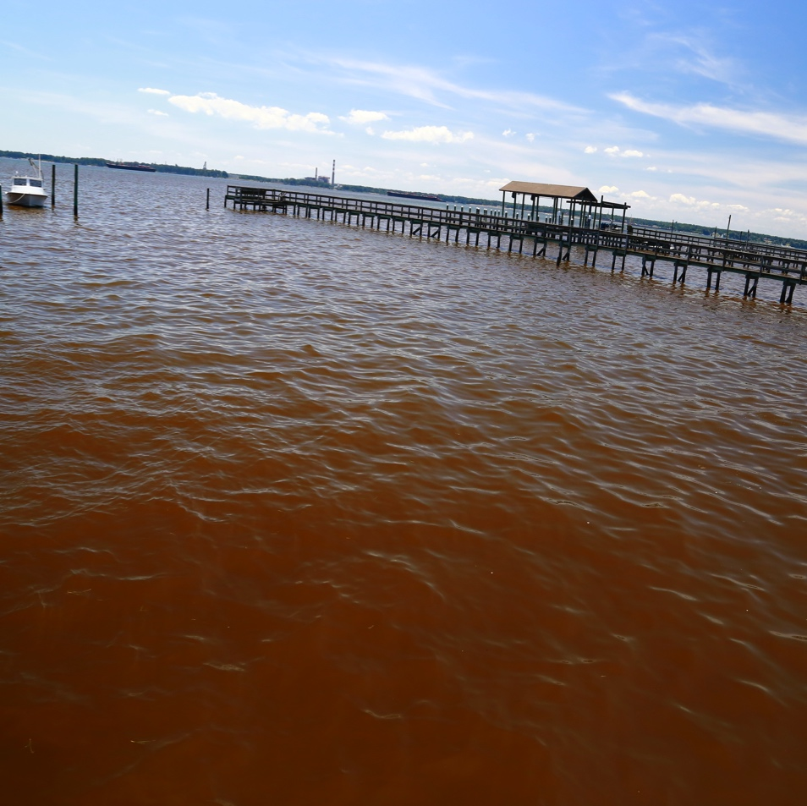
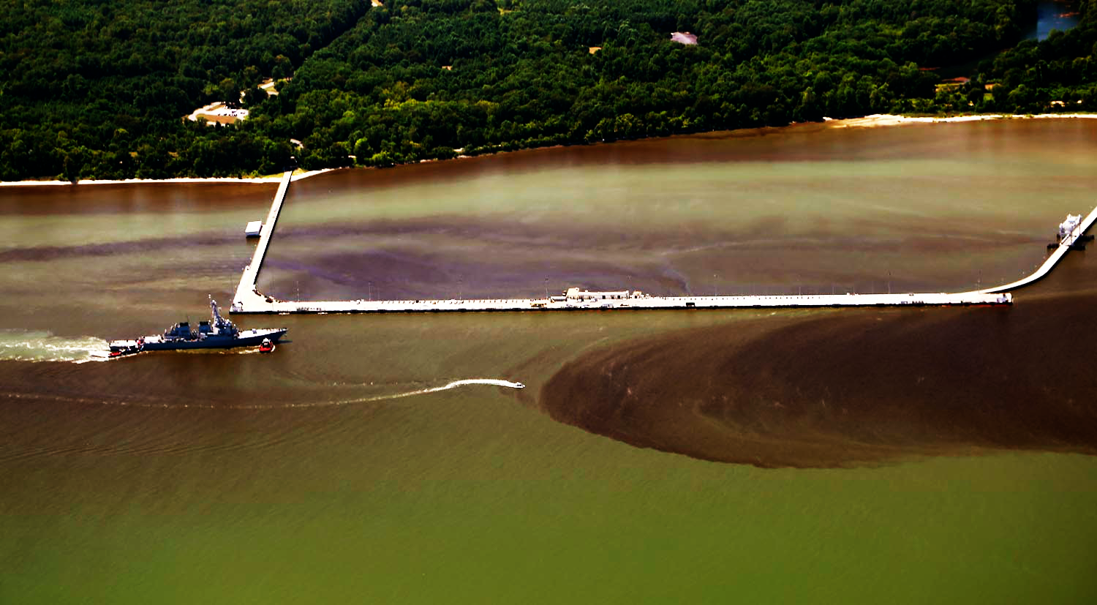
Harmful Algal Blooms (HAB)s
Blooms = rapid increase in the number of microscopic plant-like cells (phytoplankton or micro-algae) in water causing discoloration (red, mahogany, brown, green)
York River, VA 2016
Photo: Wolfgang Vogelbein
Photo: Wolfgang Vogelbein

Slide 14
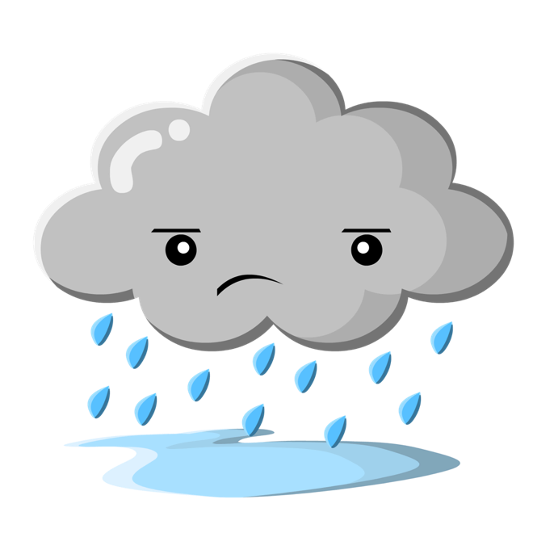

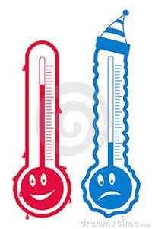

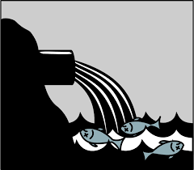

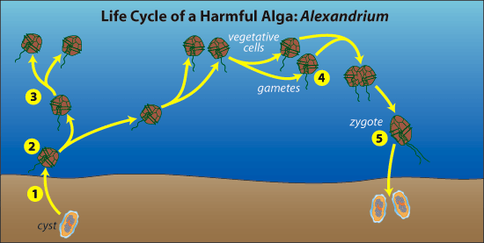


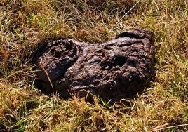
Causes/Drivers of Blooms?
WHOI

Slide 15
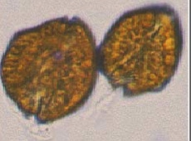
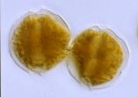
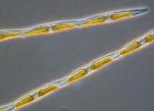
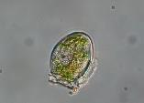
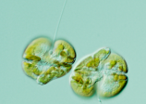
HAB-related human illnesses
HAB species
Toxin
Illness
Gambierdiscus toxicus
Cinguatoxin
Maitotoxin
Gambieric Acid
Ciguatera fish poisoning
Alexandrium fundyense/tamarense/catenella
Paralytic Shellfish Poisoning (PSP)
Domoic acid
Amnesic Shellfish Poisoning (ASP)
Dinophysis spp.
Diarrhetic Shellfish Poisoning (DSP)
Neurotoxic Shellfish Poisoning (NSP)
Brevetoxin
Saxitoxin
Pseudo-nitzschia spp.
Okadaic acid
Karenia brevis
*
*
Microcystis aeruginosa and other cyanobacteria
Microcystin
Anatoxin
Saxitoxin
Hepatoxicity, neurotoxicity
*
* Seen in Virginia waters
Photos: Nancy Lewis, Dr. Rozalind Jester, oceandatacenter.ucsc.edu, FL Fish and Wildlife
Notes:
One of the more common routes of exposure for HAB-related human illnesses is through consuming shellfish which have bioaccumulated toxins during filter-feeding, concentrating the toxins in their meat. These are the four most common forms of shellfish poisoning disease with their associated toxins and algae species which produce those toxins. Symptoms of these diseases vary greatly, and can be as mild as an upset stomach, to as serious as causing paralysis or death.
These are not new phenomena! Natives along the Pacific coast have known for centuries that you should not eat shellfish when the water is red or luminescent.

Slide 16
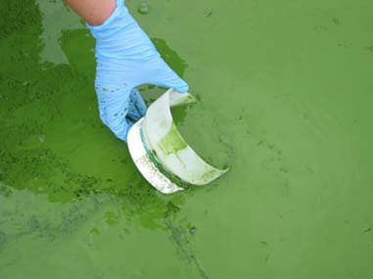
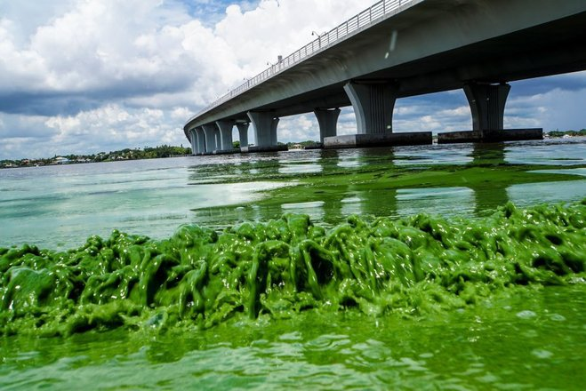
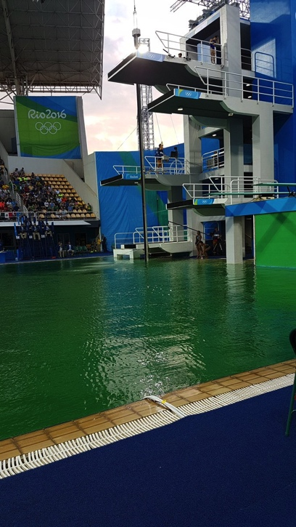
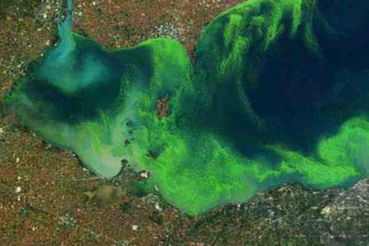
Cyanobacteria Blooms Increasing
(freshwater lakes, ponds etc.)
Florida 2016
USGS
Richard Graulich/The Palm Beach Post via AP
Lake Erie 2011
Brazil 2016
AP Photo courtesy of NOAA

Slide 17
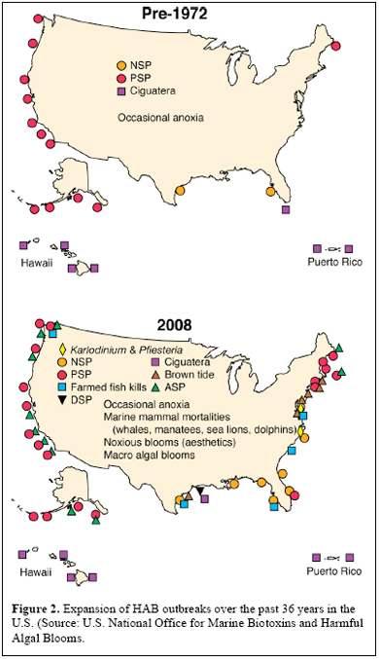
HABs Across the US (1972 and 2008)
HABs expanding range and intensity
Climate Change
Ocean Acidification
Better Monitoring and Reporting
Increased Nutrient Loading

Slide 18
HABs Across the US (2016)
https://www.whoi.edu/redtide/regions/us-distribution

Slide 19
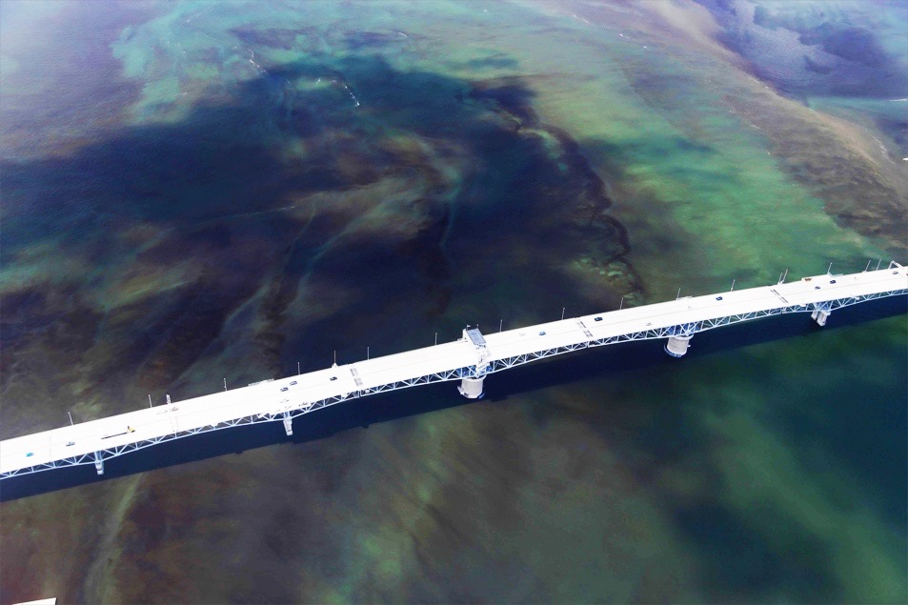
Lower Chesapeake Bay Blooms
Annual blooms of harmful phytoplankton
Occur throughout the year: VERY heavy and widespread blooms late summer - early fall (July – Sept) in VA waters, particularly for the last decade
Can lead to hypoxia/anoxia events (low oxygen levels = detrimental to marine life)
Some reports of offensive odors, shellfish, fish or crab kills
Several potentially harmful algal species involved
Photo: Wolfgang Vogelbein

Slide 20
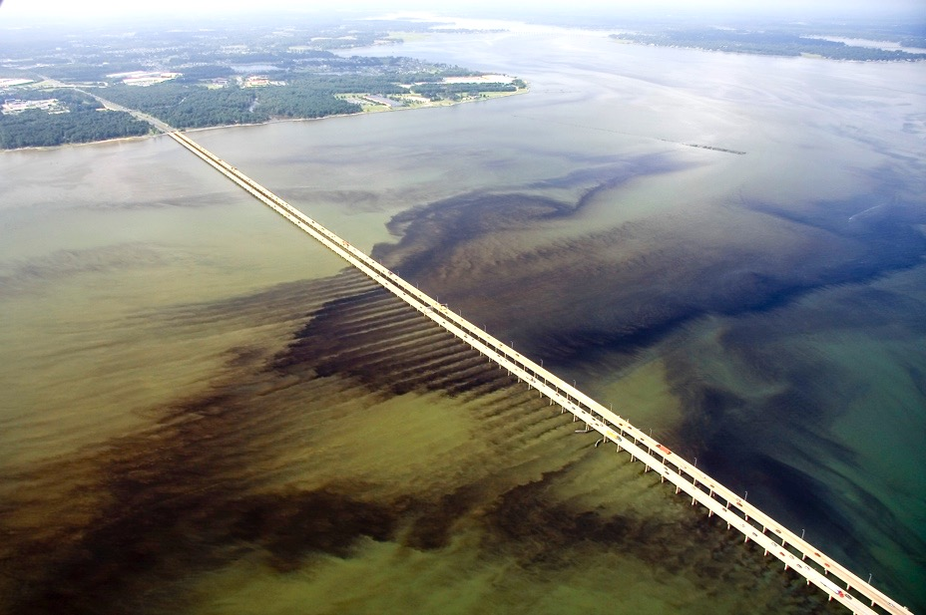
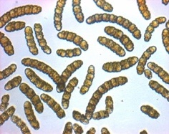
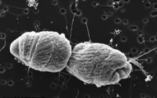

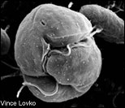
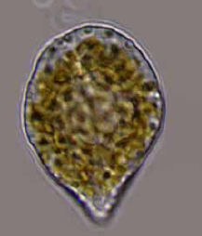
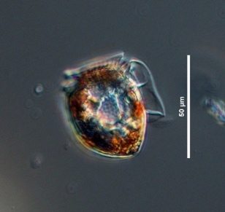
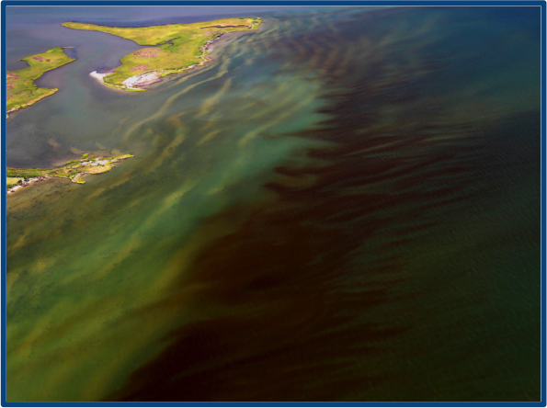

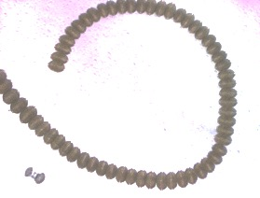
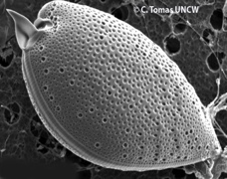

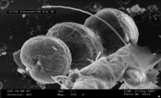
Historic and emerging patterns
Cochlodinium polykrikoides
Several other toxic HABs knocking on our door.
Alexandrium monilatum

Slide 21
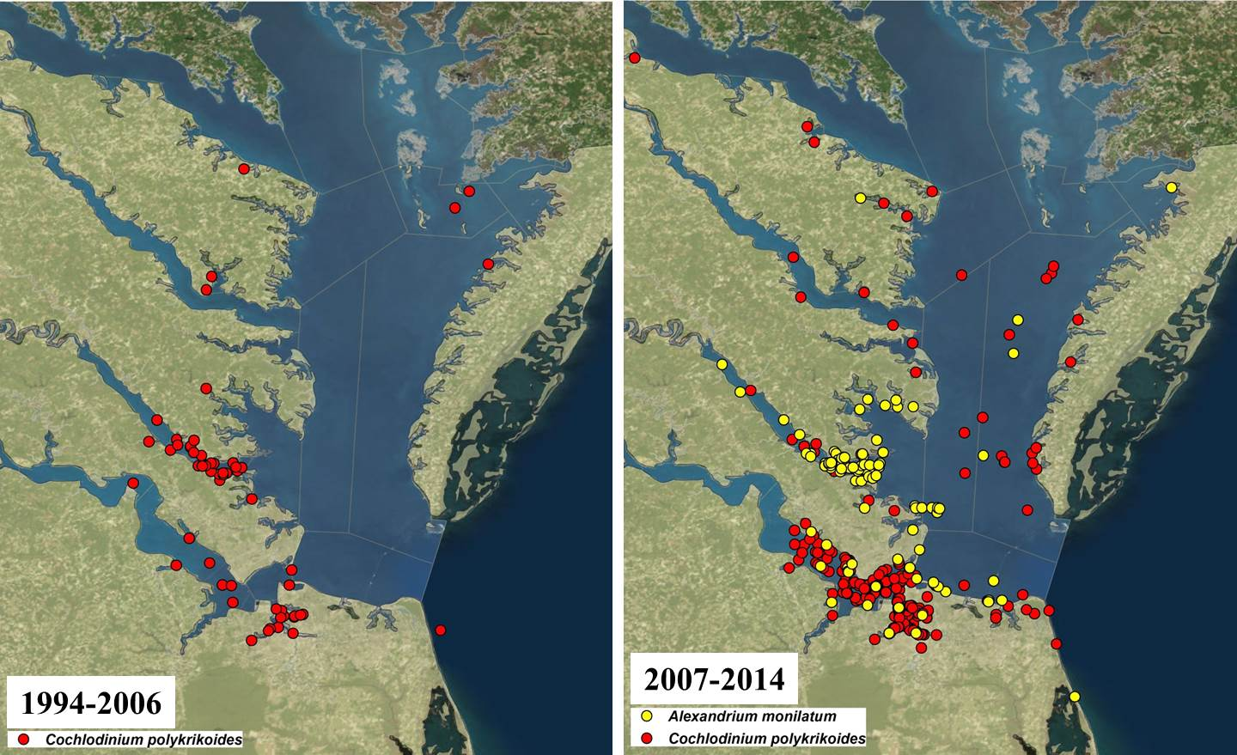


Dominant summer bloom species distribution 1994-2014
Data from Egerton and Marshall/ODU; Reece/VIMS
A. monilatum blooms observed almost annually in York River region starting in 2007
Highest densities in the York River with lower counts in samples outside the region through 2013 (expansion of A. monilatum in 2015/16)

Slide 22
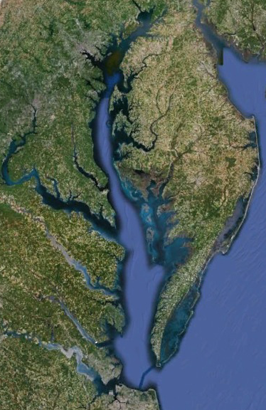
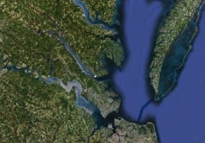
Expansion of C. polykrikoides and A. monilatum in the lower Cheseapeake Bay
Expansion north and south of the York River region. Cochlo-40+ years, Alex 9 years
Cochlo: expanded in the 1990’s (Marshall 1995, Marshall et al. 2005).
Alex: first recent bloom in the York River in 2007, expansion started 2010-12.
York River
Potomac R.
Hampton Roads
James River
Rappahannock R.
Lafayette R.
Elizabeth R.
York River
James River
Hampton Roads

Slide 23
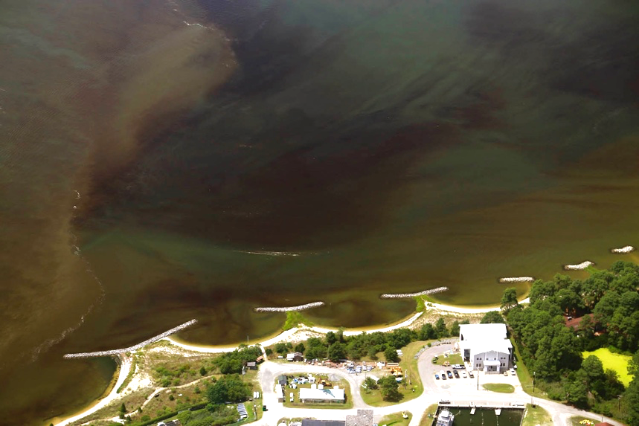
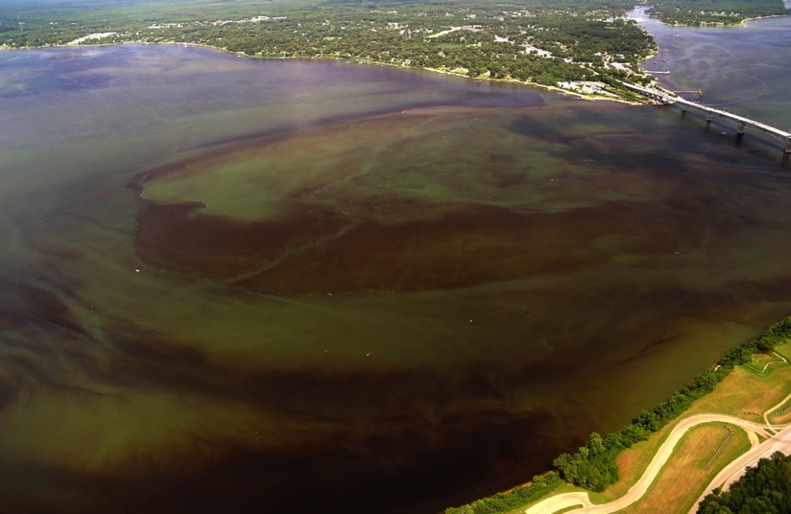
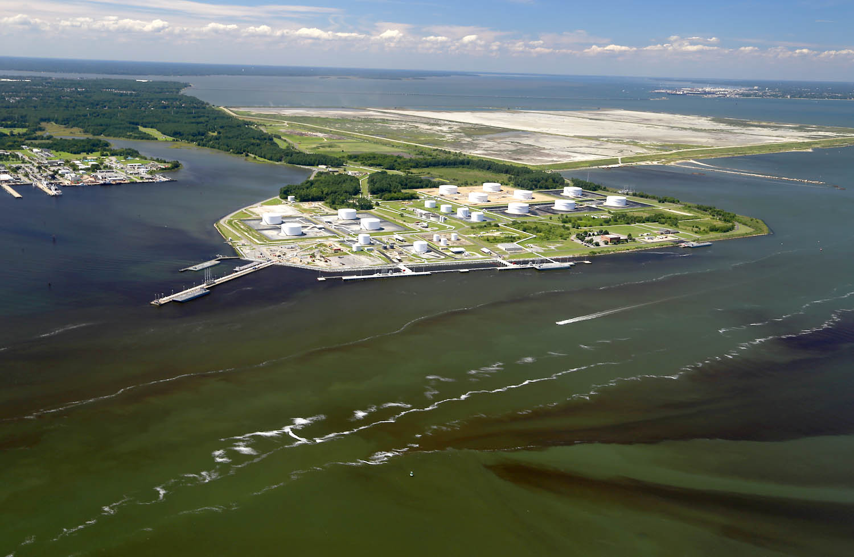
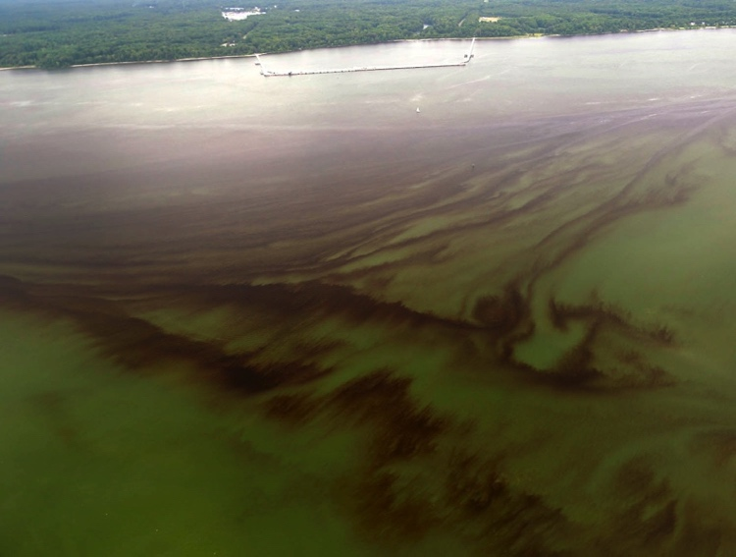
Cochlodinium polykrikoides- Early – mid August
York River-north of the Coleman Bridge
VIMS Beach- York River
Near Naval Weapons Station
Elizabeth River-C. polykrikoides
Photos by W. Vogelbein

Slide 24
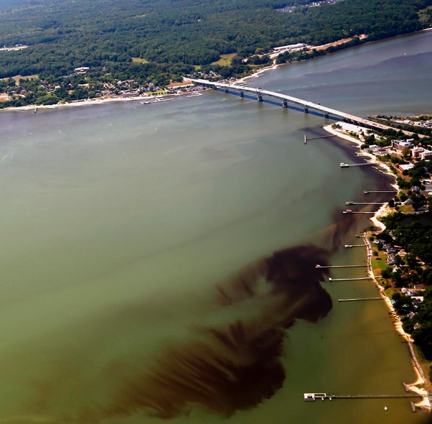
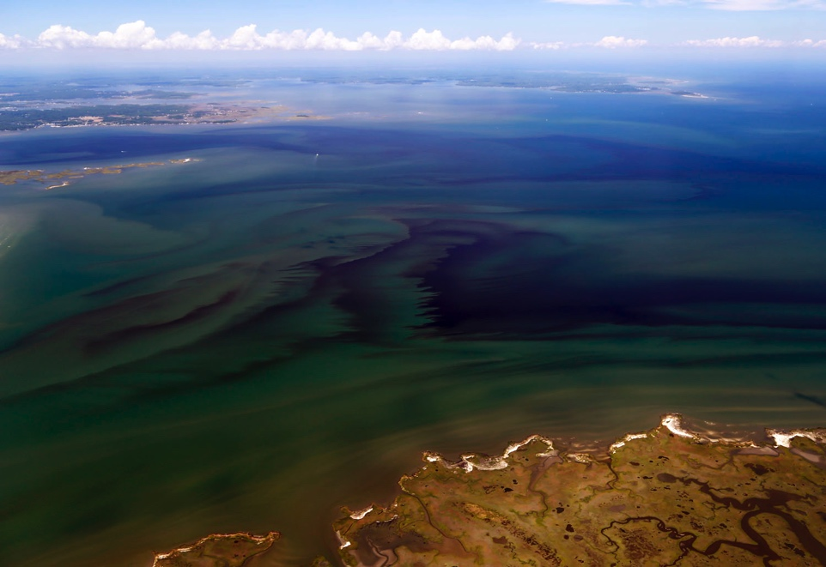
Alexandrium monilatum-Late Aug - Sept
Shellfish, crab, ray mortalities have been reported during these blooms.
Lipophilic toxic, goniodomin A, has been isolated from shellfish tissues.
Is there a human health impact?
Laboratory workers
  Mucosal irritation
  Respiratory symptoms
York River- near VIMS
Mouth of the Poquoson River
Photos by W. Vogelbein

Slide 25
Conclusions and Questions
Vibrio cases and HABs are increasing in geographic range and incidence.
Will this trend continue?
What are the emerging threats?
Increasing storm frequency could result in more frequent failures at wastewater treatment plants resulting in enteric contamination of waters and shellfish.

Slide 26
