Slide 1
Let’s Talk Climate and Health:
Messages to Motivate Americans

Slide 2
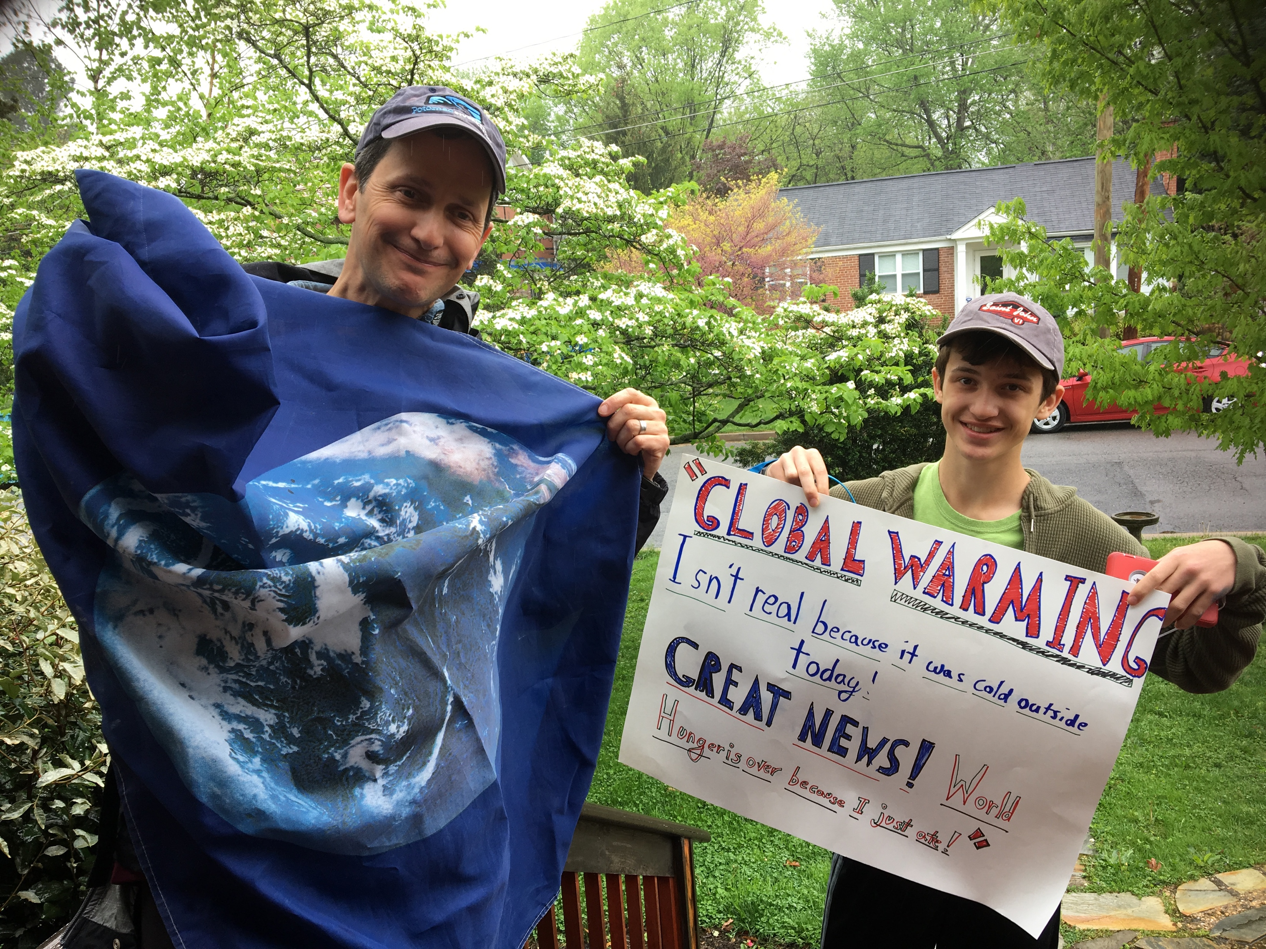
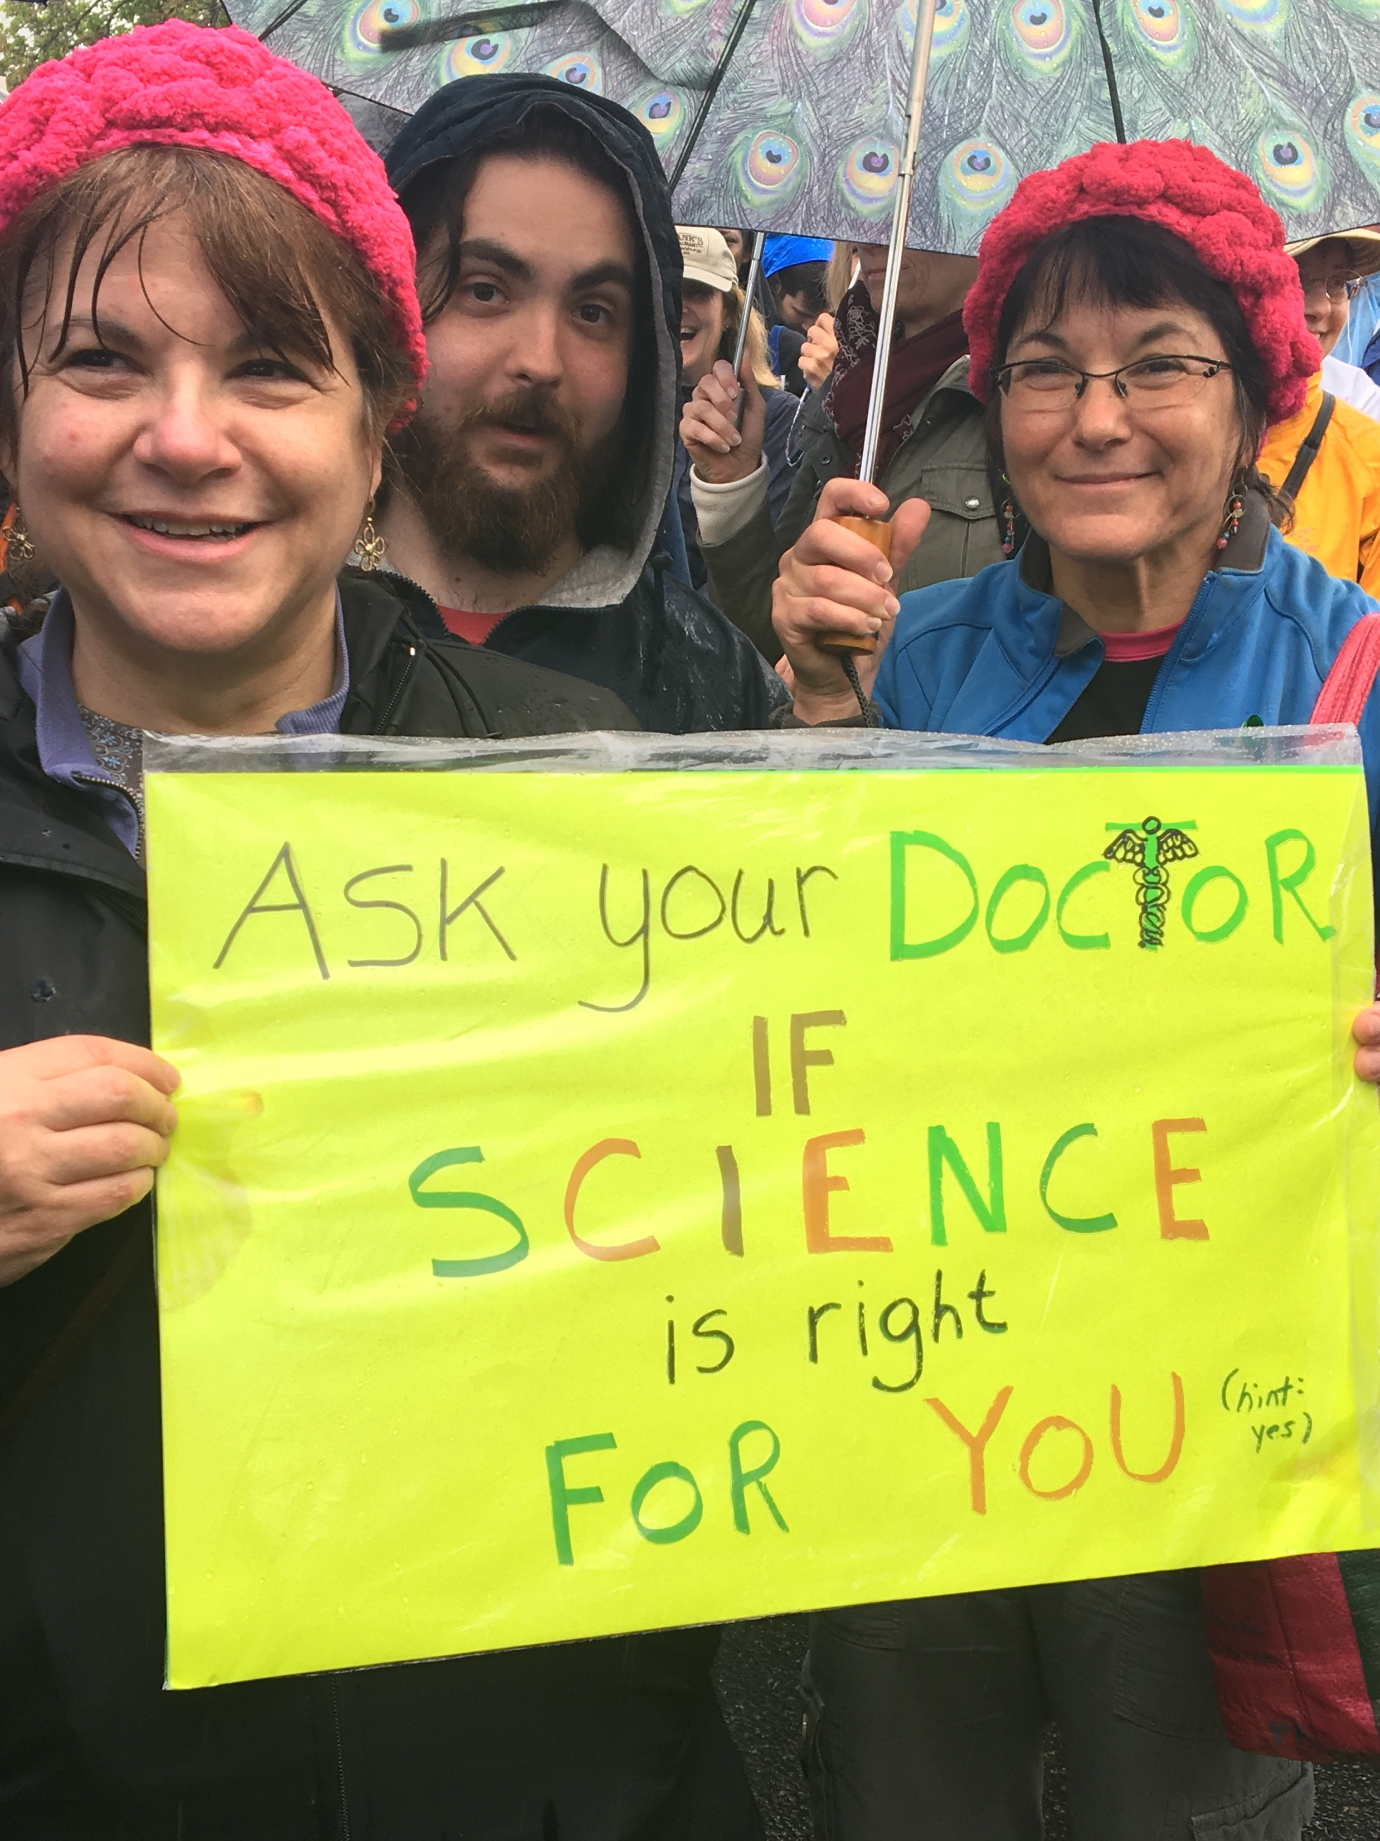
Marching with a Message…
Notes:
Good afternoon. First, thanks for being my excuse note yesterday as I begged off joining the rainy Science March with my son and husband to prepare for today. Did any of you participate in the March? My hat is off to you for pulling a double-header this weekend. As a Falls Church, VA resident, I also want to thank ALL of you for being here on behalf of our state. And thank you Dr. Ahdoot. A few years ago when we randomly sat down to (vegetarian) lunch together at a Clean Med Conference, it took me about five seconds to recognize you were a bonafide climate and health superheroine on the brink. Thank you for bringing us all together!

Slide 3
Communications: Today’s Presentation
Building Climate Leadership
What we know: Messengers & Audience
“Let’s Talk Climate & Health” Communications Guidance
What works: Tested Phrases and Messages
Key Steps to Crafting Your Personal Message
Notes:
As already impossibly busy health professionals, we know it is a big ask to add climate leadership to your plate. Since you are stepping up, I want to share the best research-based climate communication guidance and resources we have to support you to communicate effectively about climate and health.
I’ll provide a high level overview of you as trusted messengers, your audience, and what to keep in mind to make a powerful case for climate solutions.

Slide 4
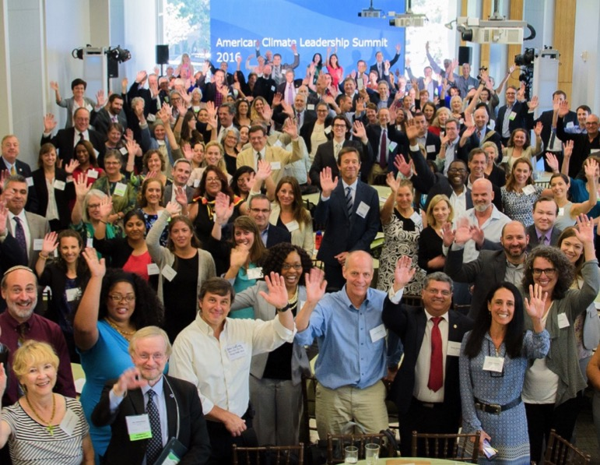
ecoAmerica
Build a critical mass of institutional leadership, public support, and political will for climate solutions in the United States.
Shift the national narrative
Build collective impact
Provide programs + resources
Notes:
Quick bit of context here: I work with ecoAmerica, a national nonprofit which seeks to expand support for climate solutions across America by engaging new and more diverse messengers who can connect with Americans by tying climate to the values they already hold dear.

Slide 5
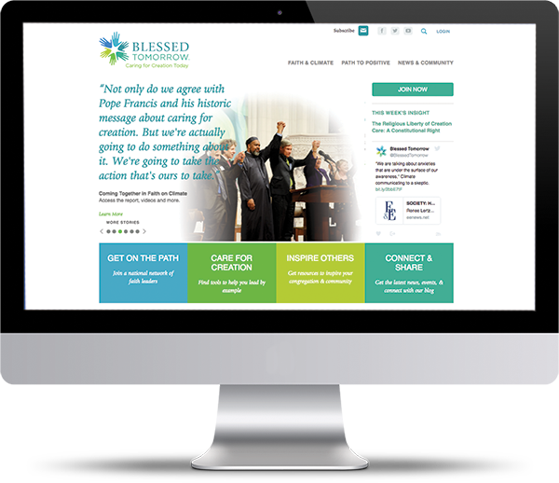
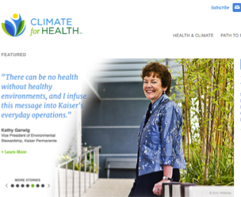
Offerings
Resources
Communications
Summits and forums
Organizational partnerships
Sector-wide collaboration
Notes:
We do this by working across the key sectors people interact with everyday, health, faith, local communities, higher education and business, to help strengthen their climate leadership.

Slide 6
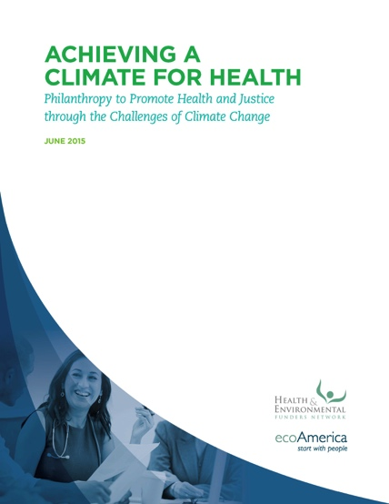
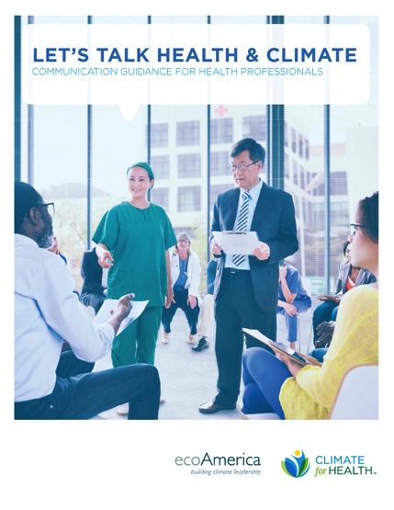
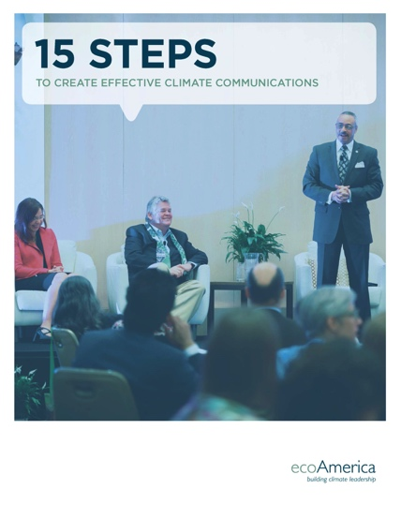
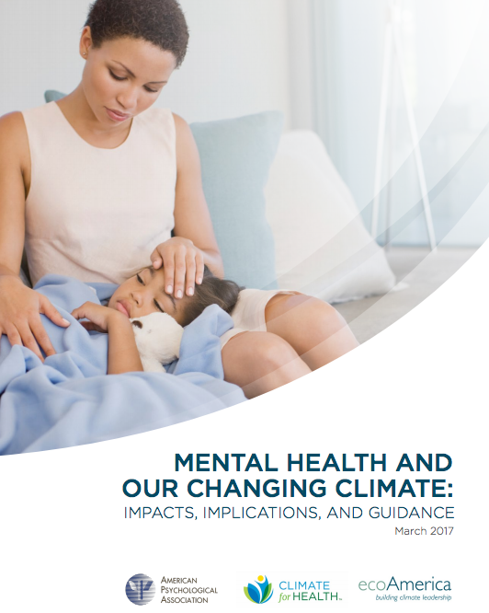
Research
Notes:
Our work is grounded in research
We do psychographic values research to understand which Americans are ready to move on climate, what they care about, and how to connect that to solutions.
We also do topical research, such as our new mental health and climate change report that we just launched in collaboration with the APA, available on the tables.

Slide 7
Who is Your Audience?
Americans and Climate Change: Research, Polling, Values
Notes:
You’ve all heard it - Communications rule #1: Know your audience.
So, what do Americans think about climate change and what do they know about the climate and health connection?

Slide 8
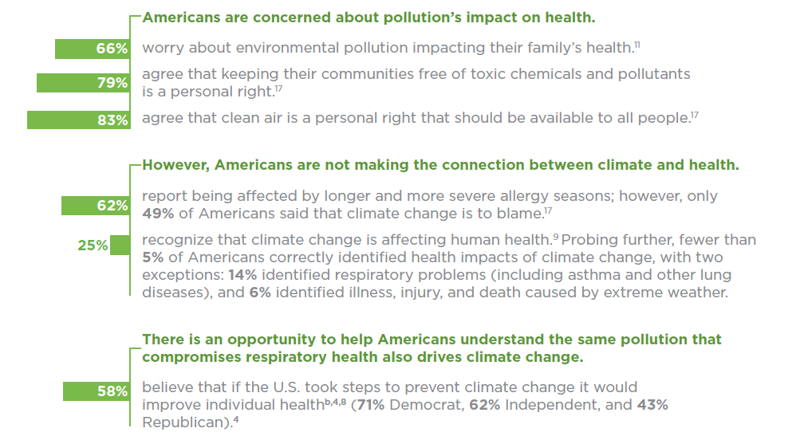
Concern
Notes:
One key thing our research tells us is that most Americans care about their health and the impact of pollution on it.
And as the 2015 Lancet Commission Report, the American Public Health Association, and an ever-growing number of health professionals concur—climate change represents the biggest public health threat facing America and the world. The impacts are widespread and are beginning to manifest now.
While about ¼ of Americans report a general sense that climate change can be harmful to health, very few understand the types of harm or who is likely to be affected. In fact, less than 5% of Americans can accurately name one or more health harm caused by climate change.
So, while Americans care about their health, most are not making the connection between damage to the climate and damage to their own health and that of their families and neighbors.

Slide 9
Health Professionals: Your Leadership Matters!
Notes:
This is where you come in!
Ours and others research indicates there is a tremendous opportunity for health professionals to help make those connections between what people already care about (their Health) and how it is directly linked with climate change.
Research tells us health and safety preparedness is a big potential motivator across the political spectrum, particularly with people, like conservatives, who are not already swayed on the need for climate solutions.
People across the board also agree they want to be healthy, and have a healthy environment to live in and 83% see clean air as a personal right for all.

Slide 10
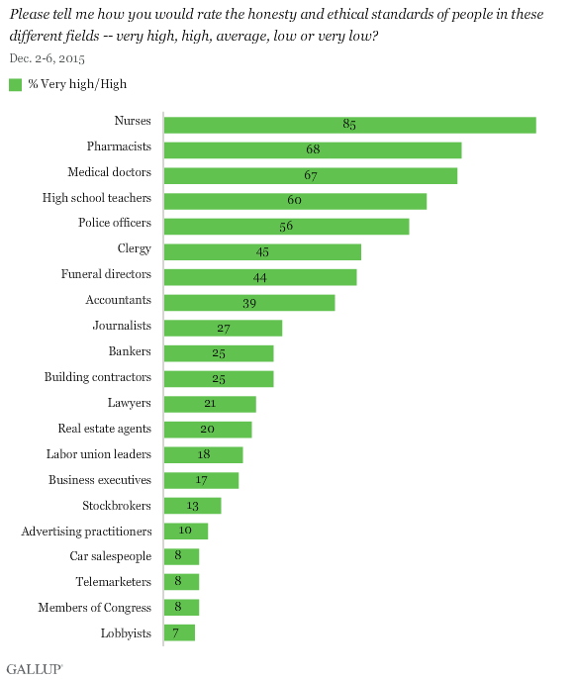
You Are The Most Trusted
Yikes!
Notes:
Not only is health a safe entry point for talking about climate change, research tells us that, Americans trust their nurses, doctors and other health professionals the most as sources for credible information on climate change.
And you have extensive reach: 83% of all Americans have contact with a health professional at least once a year.

Slide 11
Behaviors
 | Health Professionals (%) | General Public (%)
Engage in the behaviors below
Turn up the thermostat to save energy. | 87 | 70
Eat vegetarian. | 54 | 39
Use public transportation. | 46 | 32
Bike instead of using a car. | 33 | 22
Support these local community measures
A community-wide energy savings program. | 78 | 71
Annual disaster preparedness training program. | 77 | 69
Update building codes to increase energy efficiency. | 75 | 69
Create alternatives to driving. | 74 | 62
2015 “Let’s Talk Climate” ecoAmerica and Lake Research Partners.
Notes:
So, health is a winning frame, you are trusted, and as these findings show, you are already ahead of the curve in role modeling personal leadership by adopting climate behaviors ahead of the general public. You get that taking early action, whether it is to prevent disease or address climate change, produces the greatest health benefits.
So, now we want to help you take the next step of engaging the community on this issue. We’re calling upon you to get more people to follow your lead, and to demand climate solutions of decision-makers.

Slide 12
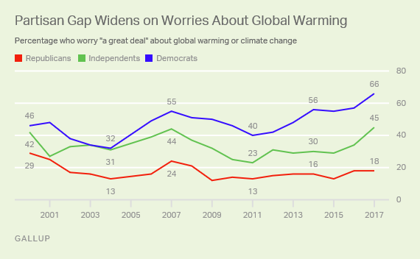
Americans – Are They Worried about Climate Change?
Notes:
Who is your audience for this work? A recent Yale University survey showed that 70% of us now believe that climate change is happening—and this was polled after the 2016 election. Indeed, about half Trump’s supporters believe that climate change is really happening.
While this may be heartening news, what’s even more important for us is looking at how much people are concerned. Per Dr. Van Susteren’s point –in the end, it is emotion that gets us to take ACTION and drives change.
Well, we seem to be in luck, and also challenged here. Based on the latest 2017 Gallup poll, 66% of Democrats are worrying a great deal about our climate. This is the highest percentage since 2000 and it’s probably not a surprise that it’s up 9 percentage points over last year's poll.
Overall, the percentage of Americans saying they worry about global warming is 45% -- the highest level in nearly three decades of Gallup polling However, only 18% of Republicans are worried. It’s worth noting, climate change wasn’t always so polarized– 17 years ago, 29% of Republicans expressed concern.
The widest gap, however, is on the importance of dealing with global climate change. About 62% of Democrats say climate should be a top priority for the president and Congress. But just 15% of Republicans say the same – making climate change by far the lowest-ranked of 21 policy priorities among Republicans.

Slide 13
American Policy Priorities
JOBS
ECONOMY
TAX REFORM
HEALTH CARE COSTS
ENVIRONMENT
CLIMATE CHANGE
Source: January 2016 Survey of National
Priorities, Pew Research Center
Notes:
So, how can we communicate effectively to help address and close this gap?
On the screen is a Pew annual survey of public policy priorities
As you can see, Americans rate climate change as one of their lowest policy priorities.
However, of the top things we care about, such as the economy, jobs, and health, issues that feel much closer to home, all of these can be helped by addressing climate change.
One of the keys to success is to align your climate messages with the issues that matter most to Americans.

Slide 14
Let’s Talk Climate and Health
Practical Guidance
Notes:
We’ve established you are well-positioned to lead, most Americans now agree the climate is changing, some are far more concerned than others, almost all are at least receptive to the health frame, but all need more help to understand that how their health is affected by climate change.
Before we dive into what works when talking about climate, let’s take a moment to review what hasn’t

Slide 15
What Do People (really) Hear About Climate?
We have been warning about this for years, and did too little to stop it.
Subtext: it’s your fault for
not listening to us
Notes:
Here’s a sample of the types of climate messages most Americans are familiar with – Here’s what is said – here’s what they hear

Slide 16
What Do People Hear About Climate?
The scientists agree that this is happening.
Subtext: you are ignorant if you
disagree, or are uncertain

Slide 17
What Do People Hear About Climate?
You need to act now to save polar bears and stop global sea level rise.
Subtext: forget about your own needs,
think about the planet

Slide 18
What Do People Hear About Climate?
Last month was the hottest month on record.
Subtext: too late, you blew it,
and we’re all going to die

Slide 19
What Do People Hear About Climate?
Weather disasters are going to keep getting worse.
Subtext: too late, you blew it,
and we’re all going to die

Slide 20
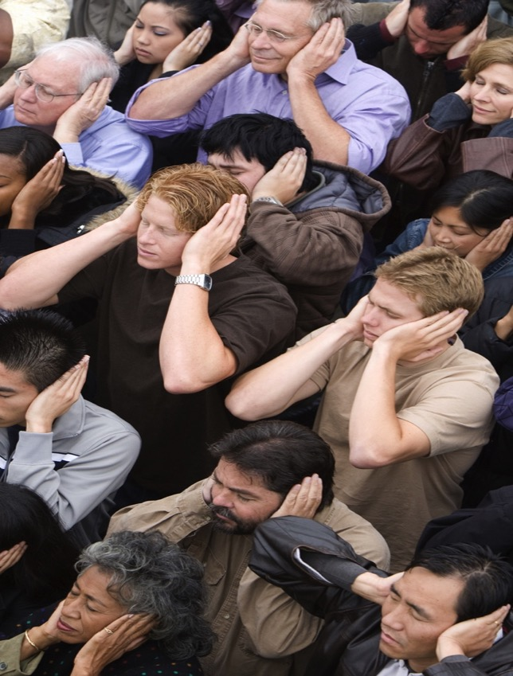
Motivated Avoidance
Fear
Confirmation bias
Techno optimism
Conflict avoidance
Competing priorities
Social norms
System justification
Fatalism & resignation
Notes:
There are many reasons why these types of messages have not resonated.
Mostly it is about motivated avoidance.
For example, people hear it as a competing priority. Such as, “I am too busy driving kids to school, running errands, and paying the bills to think about climate change.”
Or fear, such as, “I feel overwhelmed when it comes to climate change because I don’t know what to do.”
Despite many messaging attempts, so far, we have yet to position climate change as a highly relevant public health problem. We’re still dealing with it largely as an environmental issue.

Slide 21
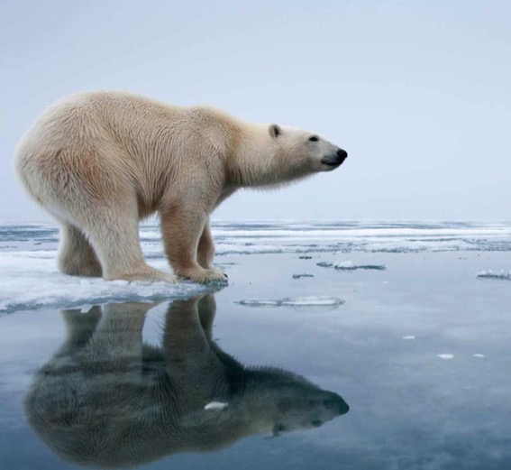
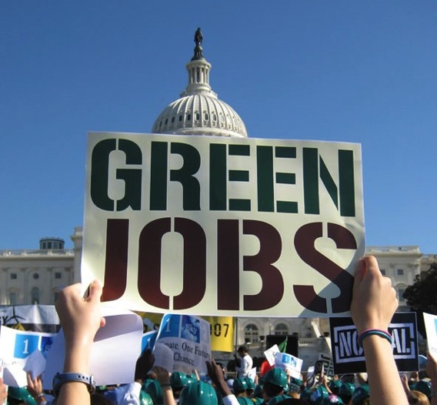
Message Evolution
<‘08
‘08
>’08
Armageddon
Social Benefits
Personal Relevance
Global Warming
Opportunity
Family and Health
Notes:
Here’s how our story of climate change has evolved, you’ll see where you come in! Over the past decade, climate advocates have spoken about climate change in many ways.
First, we talked about polar bears and sea level rise. This is a fairly Armageddon-style of messaging that taps into fear and consequences. This frame is still used a lot. It is important to acknowledge that it does work, but it works with activists and environmentalists, who at best make up about 1/3 of the population, but it doesn’t motivate everyone else.
Around 2008, with the economy in crisis, we started talking about the benefits of solutions. While this was more positive messaging, it was at a grand scale, and disconnected from everyday Americans confronting huge unemployment numbers. It was therefore doubted and easily refuted by the opposition.
What we know today, is that to inspire broader public support on climate with a larger swath of Americans, we need to connect the issue to them personally and about their lives today and the next day, not the 22nd century. Framing climate change as a public health problem first and foremost could really help spur more action. Everyone is concerned with the health of their children and communities.

Slide 22
Personal Relevance
SALIENCE, CLIMATE IMPACTS: With your own eyes. Link to daily/local lives.
UNAMBIGUIOUS SOLUTIONS: Proven solutions that solve the problem and benefit the economy, our health and our security.
AGENCY, EMPOWERMENT: You, your community, company, and nation can act.
MORAL IMPERATIVE: Responsibility to our children, families, and communities.
Notes:
There are four important points about this NEW stage of making climate change personal
One – we have to zoom in from global to local, and show people how climate matters to them. Sadly, with more flooding, heat events, and wildfires in our own backyards, more people are directly experiencing climate change.
Two – people need to understand there are proven solutions that are already available that will benefit their daily lives.
Three - Climate change is the one issue we all can do something about through almost every single thing we do each day.
Four - It is not about changing people’s values, but rather showing how solving climate change can benefit what they already feel responsible to and care about.

Slide 23
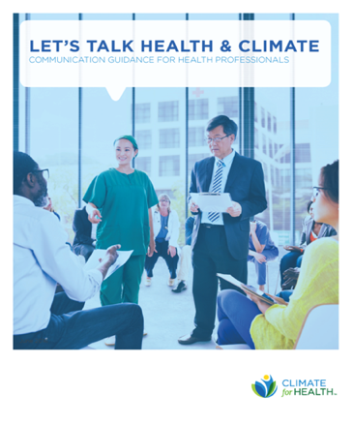
Let’s Talk Climate and Health: Communication Guidance For Health Professionals
climateforhealth.org/lets-talk
Notes:
This past year we produced a new communications guide and webinar, Let’s Talk Health and Climate, to help health professionals align with this new narrative of personal relevance.
We aim to help you get your message across, sidestep communication barriers, and motivate others around you to take action on solutions.
Hard copies are available here for you today, but you can also download it free on-line and share with others.

Slide 24
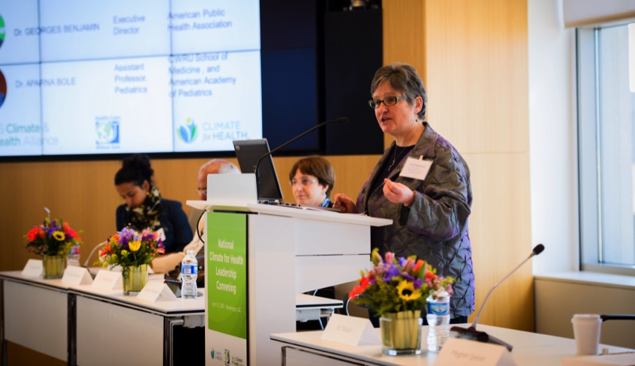
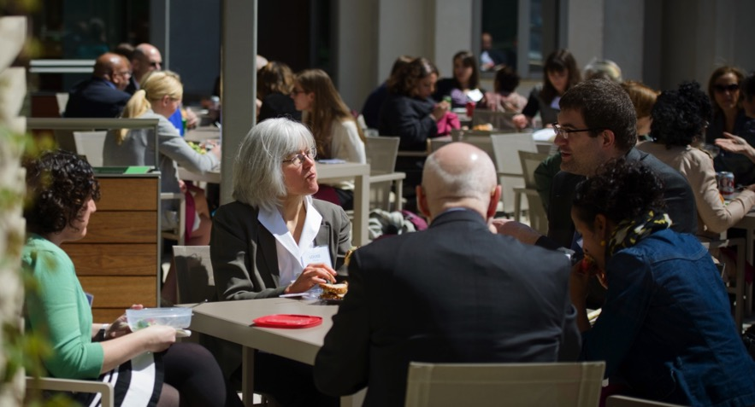
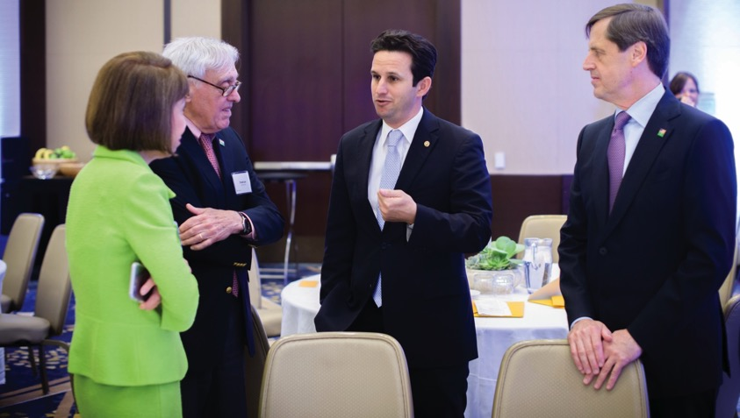
Writing a letter to an editor
Giving a speech
Informal conversation
Talking with elected officials
Notes:
Our guide is designed to help you communicate about climate change across a variety of platforms:
Giving a speech
Talking informally with friends, family, or fellow community members
And for those of you motivated towards advocacy, language that works with politicians

Slide 25
#1 Successful Tested Message = Health
“Our families’ health matters. When the American Lung Association tells us that toxic pollution in the air we breathe is affecting the health of nearly half of all Americans, we need new solutions. Kids seem to carry inhalers almost as often as lunch boxes. Seniors are stuck inside when weather shifts dramatically to extreme heat or freezing cold. Thankfully, we have a plan for a healthier future. We can use safe, clean energy, like wind and solar, that helps make every breath we take a healthy one. We can walk or bike more often to improve our fitness while cutting down on pollution. And we can make our cities more sustainable so that we can live our best lives. We can care for our climate to care for our health.”
Notes:
I can’t go into depth now, but here is glance at the guide’s tools:
Inside you’ll find a sample message on health and climate to use as a jumping off point

Slide 26
REPLACE | EMBRACE | BECAUSE
Global warming, climate crisis, climate change, climate risk | Damage to the climate | “damage” implies human causation, which can be prevented or protected against
Scientists agree | [a trusted health messenger] | Americans think “science” is debatable but trust the American Lung (or Heart) Association on pollution and health
Threats to the environment/air | Air we breathe | Visual language connects more closely with our primary health needs
Walk and bike (alone) | Walking and biking improves fitness and reduces air pollution | Walking and biking for fitness is more universal/compelling than for recreation
Don’t endanger our health by burning fuel | Live our best lives | Alarming language is scary. A hopeful visual is more motivating
Natural fuels | Wind and solar energy | Coal and oil are considered by some to be “natural fuels”
Stop/mitigate climate change | Create healthy and safe communities, protect our families’/children’s health | Focusing on positive outcomes and personal benefits motivates people to act
Notes:
You’ll also find a key reference chart that shows more effective and less effective words and phrases for you to use

Slide 27
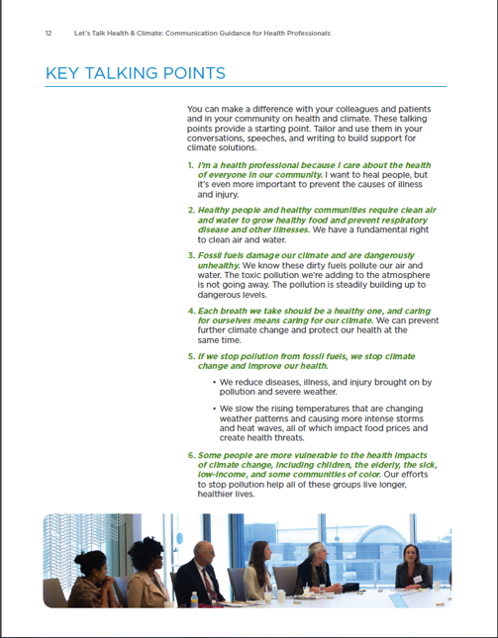
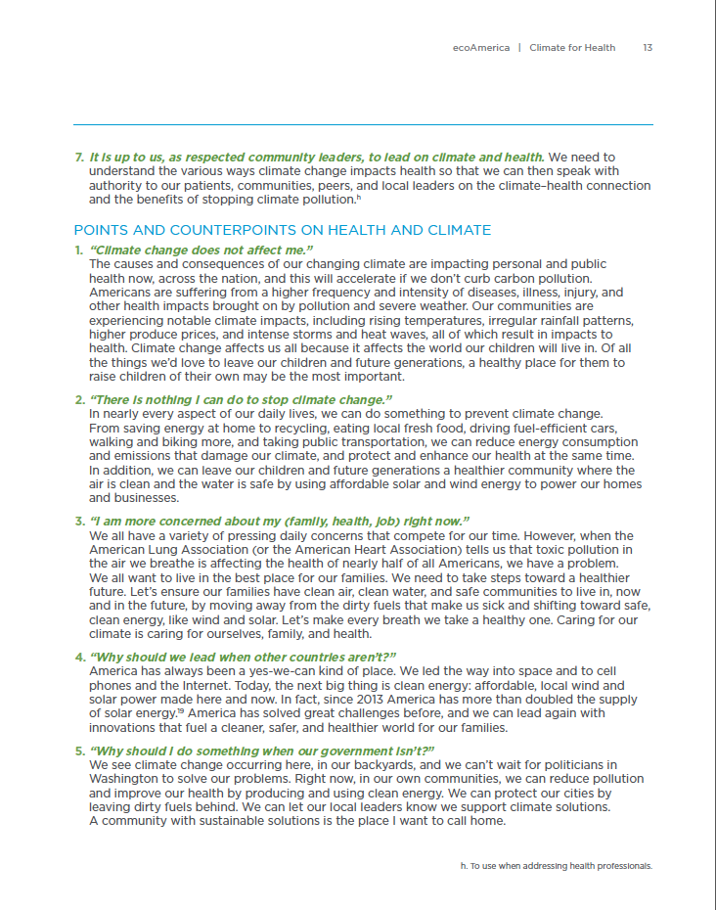
Notes:
And we included a detailed set of talking points and counter points.

Slide 28
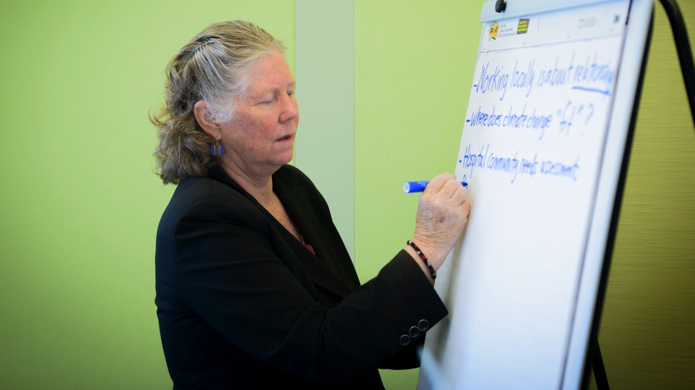
Crafting A Successful Personalized Message
28
Notes:
So you’ve got a cheat sheet for specific words, phrases and talking points that are most successful
How do you put it together to create your own unique message?
While there is a 15 step-by-step sequential process for crafting a message to guide your efforts, I’ll share here just a few of the most important recommendations.

Slide 29
1. Start With People, Stay With People
Show your audience you care about them
Start from their perspective
Use tangible and relevant health concerns
Move from people to climate
Proprietary
www.ClimateforHealth.org/lets-talk
29
Notes:
First point: Start with People, Stay with People.
Start from their perspective; if you’re talking to a colleague, a patient, a policy maker, ask yourself, what sort of situations does my audience encounter day-to-day? How can you show you care about their chief concerns?
Another way to think about this, is to talk about personal values such as family VERSUS technology, policy, and planet; which are impersonal

Slide 30
2. Connect On Common Values
Understand your audience’s priorities and concerns
Common values are powerful motivators
Connect shared values to caring for health and climate
Build rapport
Proprietary
www.ClimateforHealth.org/lets-talk
30
Notes:
Second, connect on common values.
You’re not trying to change your audience’s values. Rather, build common ground by showing how their deeply held values and daily priorities are similar to or the SAME AS YOURS.

Slide 31
Top Common Values in America
Family
Health
Security
American ethos: We-can-do-itism, compassion
Personal rights to clean environment for all
Responsibility to do something about climate
Notes:
Here are the common values related to climate that research shows most resonate with a broad swath of Americans.
They include family, health, security, an optimistic view that we can do something, and a right to a clean environment for all

Slide 32
3. Acknowledge Ambivalence
People have different levels of climate concern
Respect different perspectives
“We might not all agree on the cause for the recent extreme weather events, but we can agree that it affects our families and neighborhoods...”
32
Notes:
This third step is key: acknowledge ambivalence.
In every crowd, there’s a skeptic
If your message comes across too one-sided, you may cause people to shut down and not listen
A simple line such as, “We might not all agree on the cause for the recent extreme weather events, but we can agree that it affects our families and neighborhoods.” Allows people to be comfortable with their different opinions on climate change.

Slide 33
4. Make It Real
Focus on local realities people can see and feel
Assume the realities, don’t argue the science
Use one or two health-related impacts
Pivot quickly to solutions
33
Notes:
After allowing the space for differing opinions, the next step is to make climate change real.
As noted, we often talk about climate change as a global problem. The fact that we have the term “global warming” and talk about the ice caps melting reinforces the global aspect, but what does this mean to someone who isn’t a climate activist?
A lot of people don’t really listen when they hear that kind of language because it’s both literally and emotionally too distant.
Instead, focus on the impacts that people can see with THEIR OWN EYES.
For example talk about why is there an uptick in local asthma rates?

Slide 34
5. Emphasize Solutions
Highlight the co-benefits of solutions
Point to local solutions that protect our families’ health
Avoid sacrifice
34
Notes:
Once you have touched on a local impact, it’s important to move quickly to step number 5 - emphasize solutions.
Remember that we want to build climate concern, but also want to prevent concern from turning into fatalism.
In this step, your audience needs to hear about solutions that are tangible, effective, and local, and already happening, such as a new community bike share program.
And remember, to appeal to a broader audience, avoid asking anyone to sacrifice. Most don’t want to hear that acting on climate comes with a personal price.

Slide 35
6. Inspire & Empower
Doom and gloom doesn’t motivate
Focus on hope and opportunity
We can make a difference
America can lead on climate
Notes:
People are sick and tired of being sick and tired, therefore step 6, inspire and empower, is important.
Recall that messages about climate change are often all doom and gloom, which causes people to shut down and not listen.
Instead, talk about hope and opportunity that comes with a cleaner, healthier planet

Slide 36
7. Focus On Personal Benefit
Personal relevance
Climate action doesn’t come with a cost on lifestyle
Always emphasize the co-benefits of solutions
Image here
36
Notes:
Step 7 is to focus on the personal benefit
This is the part of the climate conversation that has been greatly missing to date, and is the key to deepening personal resonance and motivation for solutions
Americans currently think climate action will cost them personally, when we know the opposite is true!
There are many personal benefits for solving climate change, and it is important to emphasize them in every communication. We cannot stress this enough!

Slide 37
8. End With Your Ask
Turn awareness into action
Give examples that align with your audience’s goals
Make the ask accessible
Provide one or two ideas
37
Notes:
Step 8 is where you crescendo, with your ask.
Do you want to ask them to invest in clean energy, talk with their colleagues about climate, or support a city-wide efficiency program?
Align the ask with their understanding and personal values.
Stick to one or two specific ideas
Offering too many options may be confusing and overwhelming.

Slide 38
Thank You!
Jennifer Tabola, Senior Director Climate for Health
jennifer@ecoamerica.org
Twitter: @Climate4Health
Facebook: facebook.com/ClimateforHealth
Website: www.climateforhealth.org
Notes:
You are uniquely and powerfully positioned to advance the message that climate solutions are a health priority and will provide enormous health benefits.
I hope this information and our guide are useful to you.
And now, I’m going to practice what I preached and end with an ask, Please go forth and personally commit to talking more about the climate and health connection so we can protect the health of current and future generations.
Thank you!

