Slide 1
Medical Alert! Climate Change is Harming our Health
www.medsocietiesforclimatehealth.org
Facebook: Medical Society Consortium
Twitter: @docsforclimate
#climateandhealth

Slide 2
Report Released March 15, 2017
Consortium mission is to inform the public & policymakers about the harmful health effects of climate change and the benefits of climate solutions.
Report released with Consortium launch
16 societies representing >450,000 doctors, more than half of U.S. doctors

Slide 3
18 Medical Society Members
American Medical Association
American Academy of Allergy Asthma and Immunology
American Academy of Family Physicians
American Academy of Pediatrics
American College of Physicians
American College Emergency Physicians (CA chapter)
American College of Preventive Medicine
American Association of Community Psychiatrists
American Congress of Obstetrics and Gynecologists
Academy of Integrative Health & Medicine
American Geriatric Society
American Podiatric Medical Association
American Telemedicine Association
American Medical Women’s Association
National Medical Association
Society of General Internal Medicine
Academy of Integrative Health and Medicine
American College of Lifestyle Medicine

Slide 4
Why was this Report Released?
Most Americans (70%) understand that climate change is real and are concerned about it.
However, most still see climate change as a faraway threat, in both time and place, and as something that threatens the future of polar bears not people.
A minority understand believe that climate change is a threat to Americans.
The reality is starkly different: climate change is already causing problems in communities in every region of our nation, and from the perspective of physicians, it’s harming our health.
This report is intended to fill this knowledge gap.
Source: Leiserowitz, A., Maibach, E., et.al. Climate change in the American mind: November 2016. Yale University and George Mason University.

Slide 5
Scientific Agreement is Overwhelming
There is a scientific consensus about human-caused climate change.
The reality of human-caused climate change is no longer a matter of debate.
Based on the evidence, more than 97 percent of climate scientists have concluded that human-caused climate change is happening.
Many studies have proven this fact.
There are many sources of converging evidence

Slide 6
Climate Change is Harming Our Health
In communities across the nation, climate change is harming our health now.
Doctors know this because they’re seeing the health of their patients being harmed.*
Public health professionals know this too, because they’re seeing increasing rates of health problems associated with climate change in their communities.
These harms include heat-related illness, worsening chronic illnesses, injuries and deaths from dangerous weather events, infectious diseases spread by mosquitoes and ticks, illnesses from contaminated food and water, and mental health problems.
*Sarfaty M, et. al., physician survey publications available on request

Slide 7
Some Americans Face Greater Risk
The health of any American can be harmed by climate change, but some of us face greater risk than others.
Children
Student athletes
Pregnant women
Elderly individuals
People with chronic illnesses and allergies
People with limited resources

Slide 8
Concerted Action is Needed
Unless we take concerted action, these harms to our health are going to get much worse.
The sooner we take action, the more we can prevent more harm and protect the health of all Americans.
More efficient and cleaner energy will give us cleaner air and water and help prevent further climate change.

Slide 9
The Health Harms of Climate Change?
Now for harms and physician stories that illustrate those harms…

Slide 10
Health Effect 1: Air Pollution
Fire, smog, pollen and soot plus microparticulates

Slide 11
Health Effect: Air Pollution
What is happening? Climate change reduces air quality because heat increases smog, wildfires, and pollen production.
[Note: emissions + heat + light = ozone]
How does that harm our health? Poor air quality increases asthma and allergy attacks, and can lead hospitalizations, and deaths. Microparticulates evoke lung and cardiovascular symptoms.
Who is being harmed? Anyone can be-- but people with preexisting respiratory conditions such as asthma or chronic lung disease are most vulnerable.

Slide 12
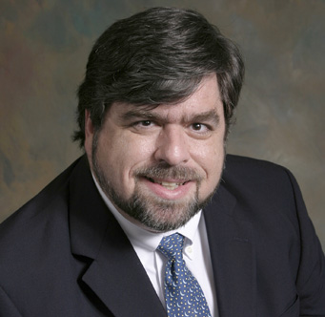
Story of Dr. John Meredith Emergency Physician Eastern Carolina University
June 2008, a wildfire devastated eastern North Carolina.
Starting in the midst of the state’s worst drought, the Evans Road Wildfire burned more than 45,000 acres and cost $20 million to battle.
Fire burned three long months that summer and plumes of smoke carrying particulates covered the eastern side of the state.
Researchers saw this fire as an opportunity to learn more about the harms to our health from air pollution resulting from wildfires.
They studied two sets of counties in North Carolina: those that were affected by the smoke and those that were not. They tallied respiratory conditions, including asthma, pneumonia, and common respiratory infections, as well heart attacks and other cardiac conditions.

Slide 13
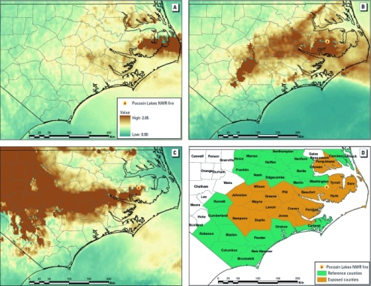

Slide 14
The Comparison of Counties
People living in counties affected by the plume had a 50 percent increase in the trips to emergency rooms from respiratory illness like Chronic Obstructive Pulmonary Disease (COPD), pneumonia, bronchitis.
The smoke caused a spike in emergency department visits for heart disease.
Blazing forests are just as damaging to human health as they are to homes and neighborhoods.
Notes:
N.B. : Temps and droughts from climate change are increasing the number/size of wildfires and fire season is >2 months longer in some states

Slide 15
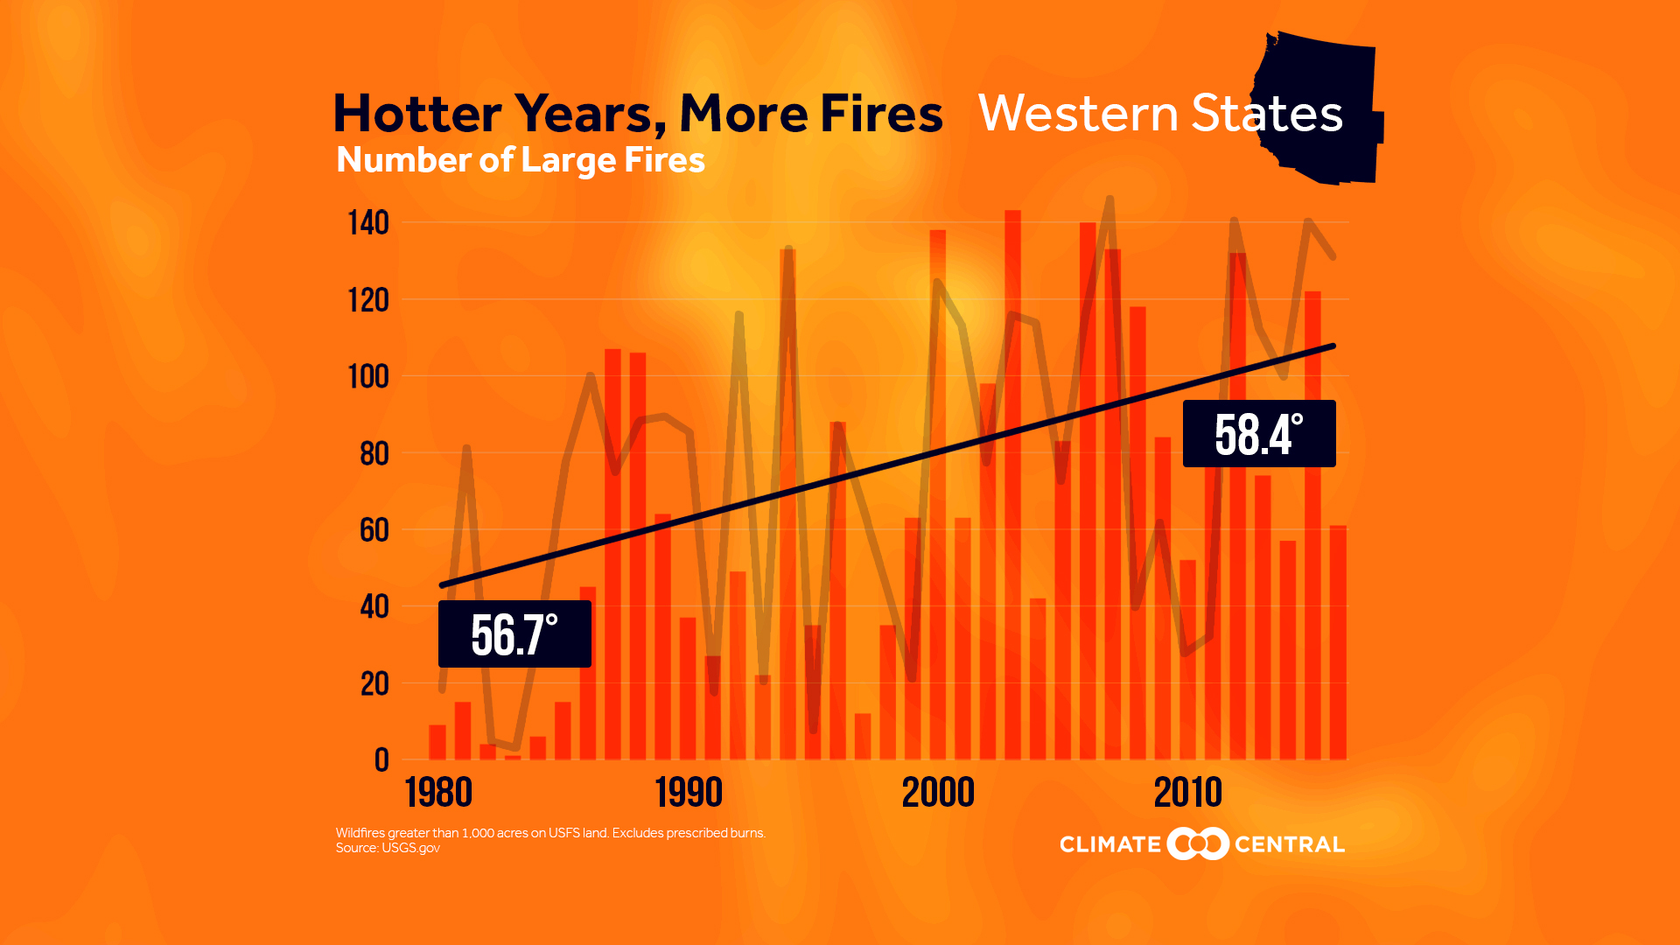
Wildfires > 1000 Acres
Wildfires have burned more than 4.5 million acres in the U.S. so far in 2017. That’s 38 percent more than the average acreage burned for the year-to-date over the past decade.

Slide 16
Health Effect 2: Extreme Weather
What is happening? Increases in the frequency and severity of extreme weather events (heavy downpours, floods, droughts, and major storms)
How does that harm our health? Causes injury, death, displacement; knocks out power and phone lines; damages or destroys homes; reduces the availability of safe food and water. Also can damage roads, bridges, impede access to medical care , and separate people from their medicines.
Who is being harmed? Anyone can be; but emergency evacuations pose extra health risks to children, older adults, the poor, and those with disabilities.

Slide 17
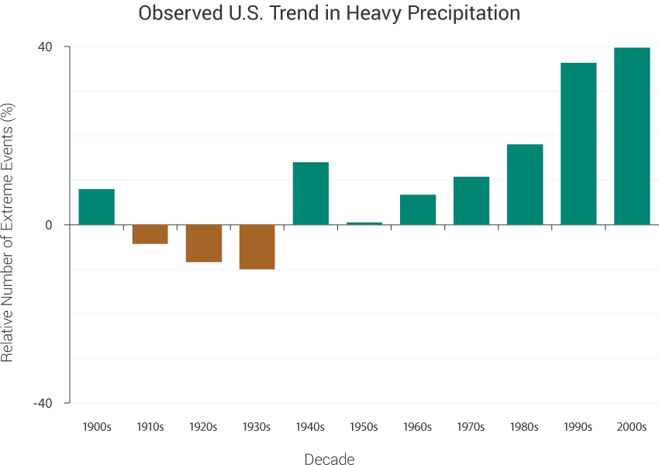

Slide 18
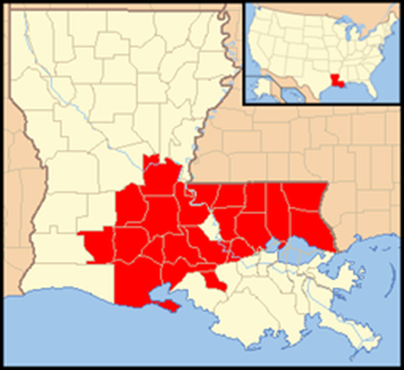
Story of Dr. Claude Tellis Retired Critical Care MD August 2016
Baton Rouge was hit with a “thousand year flood” event—a storm that has only a one-tenth of one percent chance of occurring in any given year—it rained in sheets for days.
Worst natural disaster since Hurricane Sandy
13 people died, the coast guard rescued 30,000 people, and 10,000 people ended up in shelters.

Slide 19
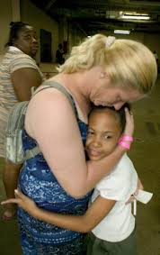
A Battered City
Governor declared state of emergency
180,000 homes, buildings damaged.(Pop. 230,000.)
Months later, homes still gutted, refrigerators, washing machines, armchairs piled high on roadsides.
This was a health crisis for many. Some fleeing their flooding homes lost their medications for hypertension, diabetes, and heart problems. Dr. Tellis and others worked with pharmacies to get these re-issued.
Many people reported stress, depression and anxiety in the weeks and months that followed.
And long after the storm passed, some teachers reported children who felt so anxious and afraid when it rained that they needed counseling.

Slide 20
Health Effect 3: Extreme Heat
What is happening? More very hot days; more humidity; longer, hotter, more frequent heat waves.
How does that harm our health? Extreme heat can lead to heat-related illness, death due to heat stroke and dehydration. Also worsens some chronic diseases (lung/heart).
Who is being harmed? Anyone can be harmed but some people face greater risk:
outdoor workers
pregnant women
student athletes
city dwellers
young children
older adults
people who lack air conditioning
people with chronic conditions
people taking certain medications

Slide 21
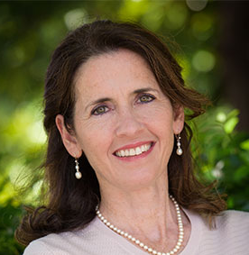
Isaac’s Story Dr. Samantha Ahdoot Pediatrician
Dr. Ahdoot’s 11 year old son, Isaac, was at band camp when she got a call from the ER—Isaac had collapsed while playing clarinet.
He experienced heat illness.
That day was part of a record-setting heatwave in Washington, DC; the heat index reached higher than 120⁰
That moment was key for her: hear her words on video (next)

Slide 22
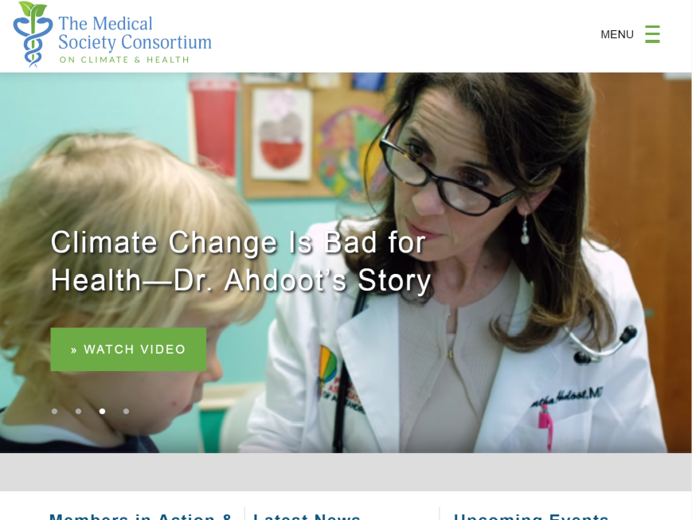

Slide 23
Sport
In August 2010, another record hot summer, Logan, a young football player, in Arkansas showed initial signs of heat illness—weakness and fatigue—during practice in his un-air- conditioned gym.
He was not treated right away and developed heat stroke, kidney failure and pulmonary edema.
Fortunately, kidney dialysis saved him. It was a close call.

Slide 24
Focus on Heat and Children
Young children don’t regulate their body temperatures like adults do and spend more time outdoors.
Emergency room visits for heat illnesses increased by 133 percent between 1997 and 2006. Almost half of these patients were children and adolescents.

Slide 25
Heat and Young Athletes
FACT: Heat illnesses are a leading cause of death and disability in young athletes. Every year, some 9,000 high school athletes are treated for heat-related illnesses.
FACT: Young men make up a third of all heat- related emergency room visits in the US.
FACT: Football players may feel the most heat. They are 11 times more likely to suffer exertional heat illnesses than players of all other high school sports combined.

Slide 26
Health Effect 4: Spread of Disease by Ticks and Mosquitos

Slide 27
Ticks and Mosquitos
What is happening? Climate change is causing increasing temperatures, too much or too little rain, and severe weather events. Heat extends further north, and at higher altitudes.
How does that harm our health? These are leading to increase in the number and geographic range of disease-carrying mosquitoes, fleas, ticks. As these insect carriers of infection move to new areas, diseases not normally found in those areas can spread.
Who is being harmed? Anyone can be harmed, but people spending more time outdoors—where these insects and other disease-carriers live—are most vulnerable . But some mosquitoes like the indoors and bite day or night.
Notes:
The tick that carries Lyme Disease is reported in 45.7% of U.S. counties, up from 30% in 1998.
Mosquitoes that carry diseases like West Nile virus and dengue fever thrive in conditions that are becoming more common. Zika virus , malaria , and even yellow fever lurk.

Slide 28
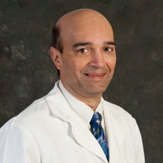
Story of Dr. Nitin Damle, Internist, President, American College of Physicians
It’s not a surprise that over the past five years, my Rhode Island internal medicine practice has seen a rise in the incidence of tick-borne diseases, including Lyme disease and other infections.
My physician colleagues used to treat two or three cases a month during tick season; now each of us sees 40 to 50 new cases during each tick season.
Those blacklegged ticks, the carriers of Lyme disease, thrive in warm, muggy weather. In Rhode Island, winters are now warmer and shorter, these tiny, sesame seed-sized insects have more time to bite humans and spread Lyme disease.
Tick season used to be relegated to summer; it now spans spring and autumn. And this isn’t limited to the typical tick hotspot states.

Slide 29
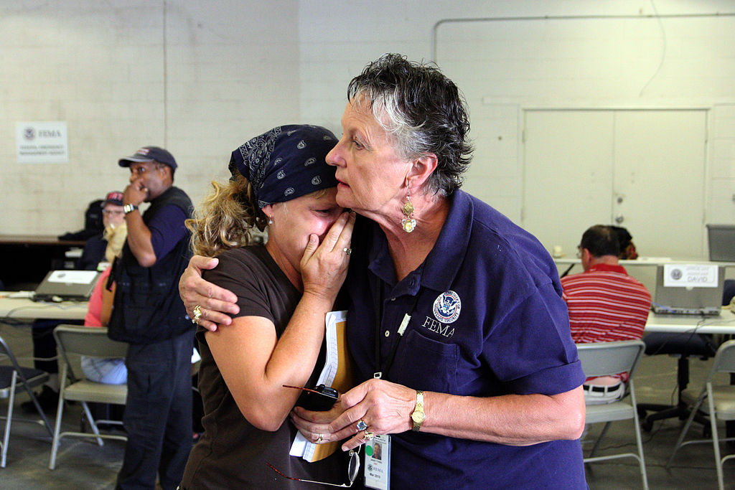
Other Impacts of Climate Change
Contaminated Food
Contaminated Water
Threats to Nutrition
Social Disruption Disturbs Well-being/ Mental Health

Slide 30
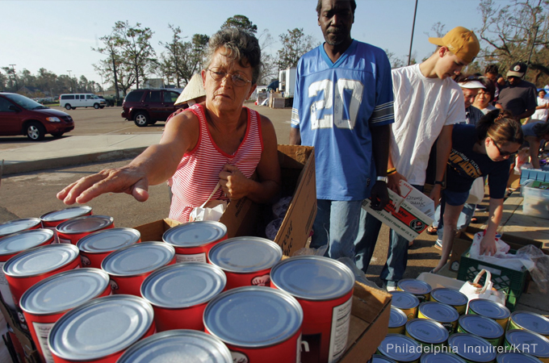
Social Disruption & Mental Health
People exposed to the worst extreme weather events experience stress and serious mental health consequences including depression, anxiety, post-traumatic stress disorder (PTSD), and increases in suicidal thoughts and behavior. (Think Syria , etc.)

Slide 31
Mental Health
Weather disasters are also associated with increases in alcohol or drug abuse. Children may experience prolonged separation from their parents.
Beyond the well-known risks specific disasters pose to our mental health, the physical, social, and economic stresses created by climate change all increase our risk of mental health problems.

Slide 32
What the Public and Doctors Think about Climate Change and Health
Only about one in three Americans are aware that people in the US are being harmed “right now” by climate change.
Physicians in three medical societies were asked the following question: In which of the following ways, if any, do you think your patients are currently being affected by climate change? (N=1868-1908) Two out of three doctors think climate change has direct relevance right now to patient care.
Physicians say the most common ways in which climate change is harming their patients’ health are through poor air quality, worsening allergies, injuries due to storms, heat-related illness, and infections spread by mosquitoes and ticks.

Slide 33
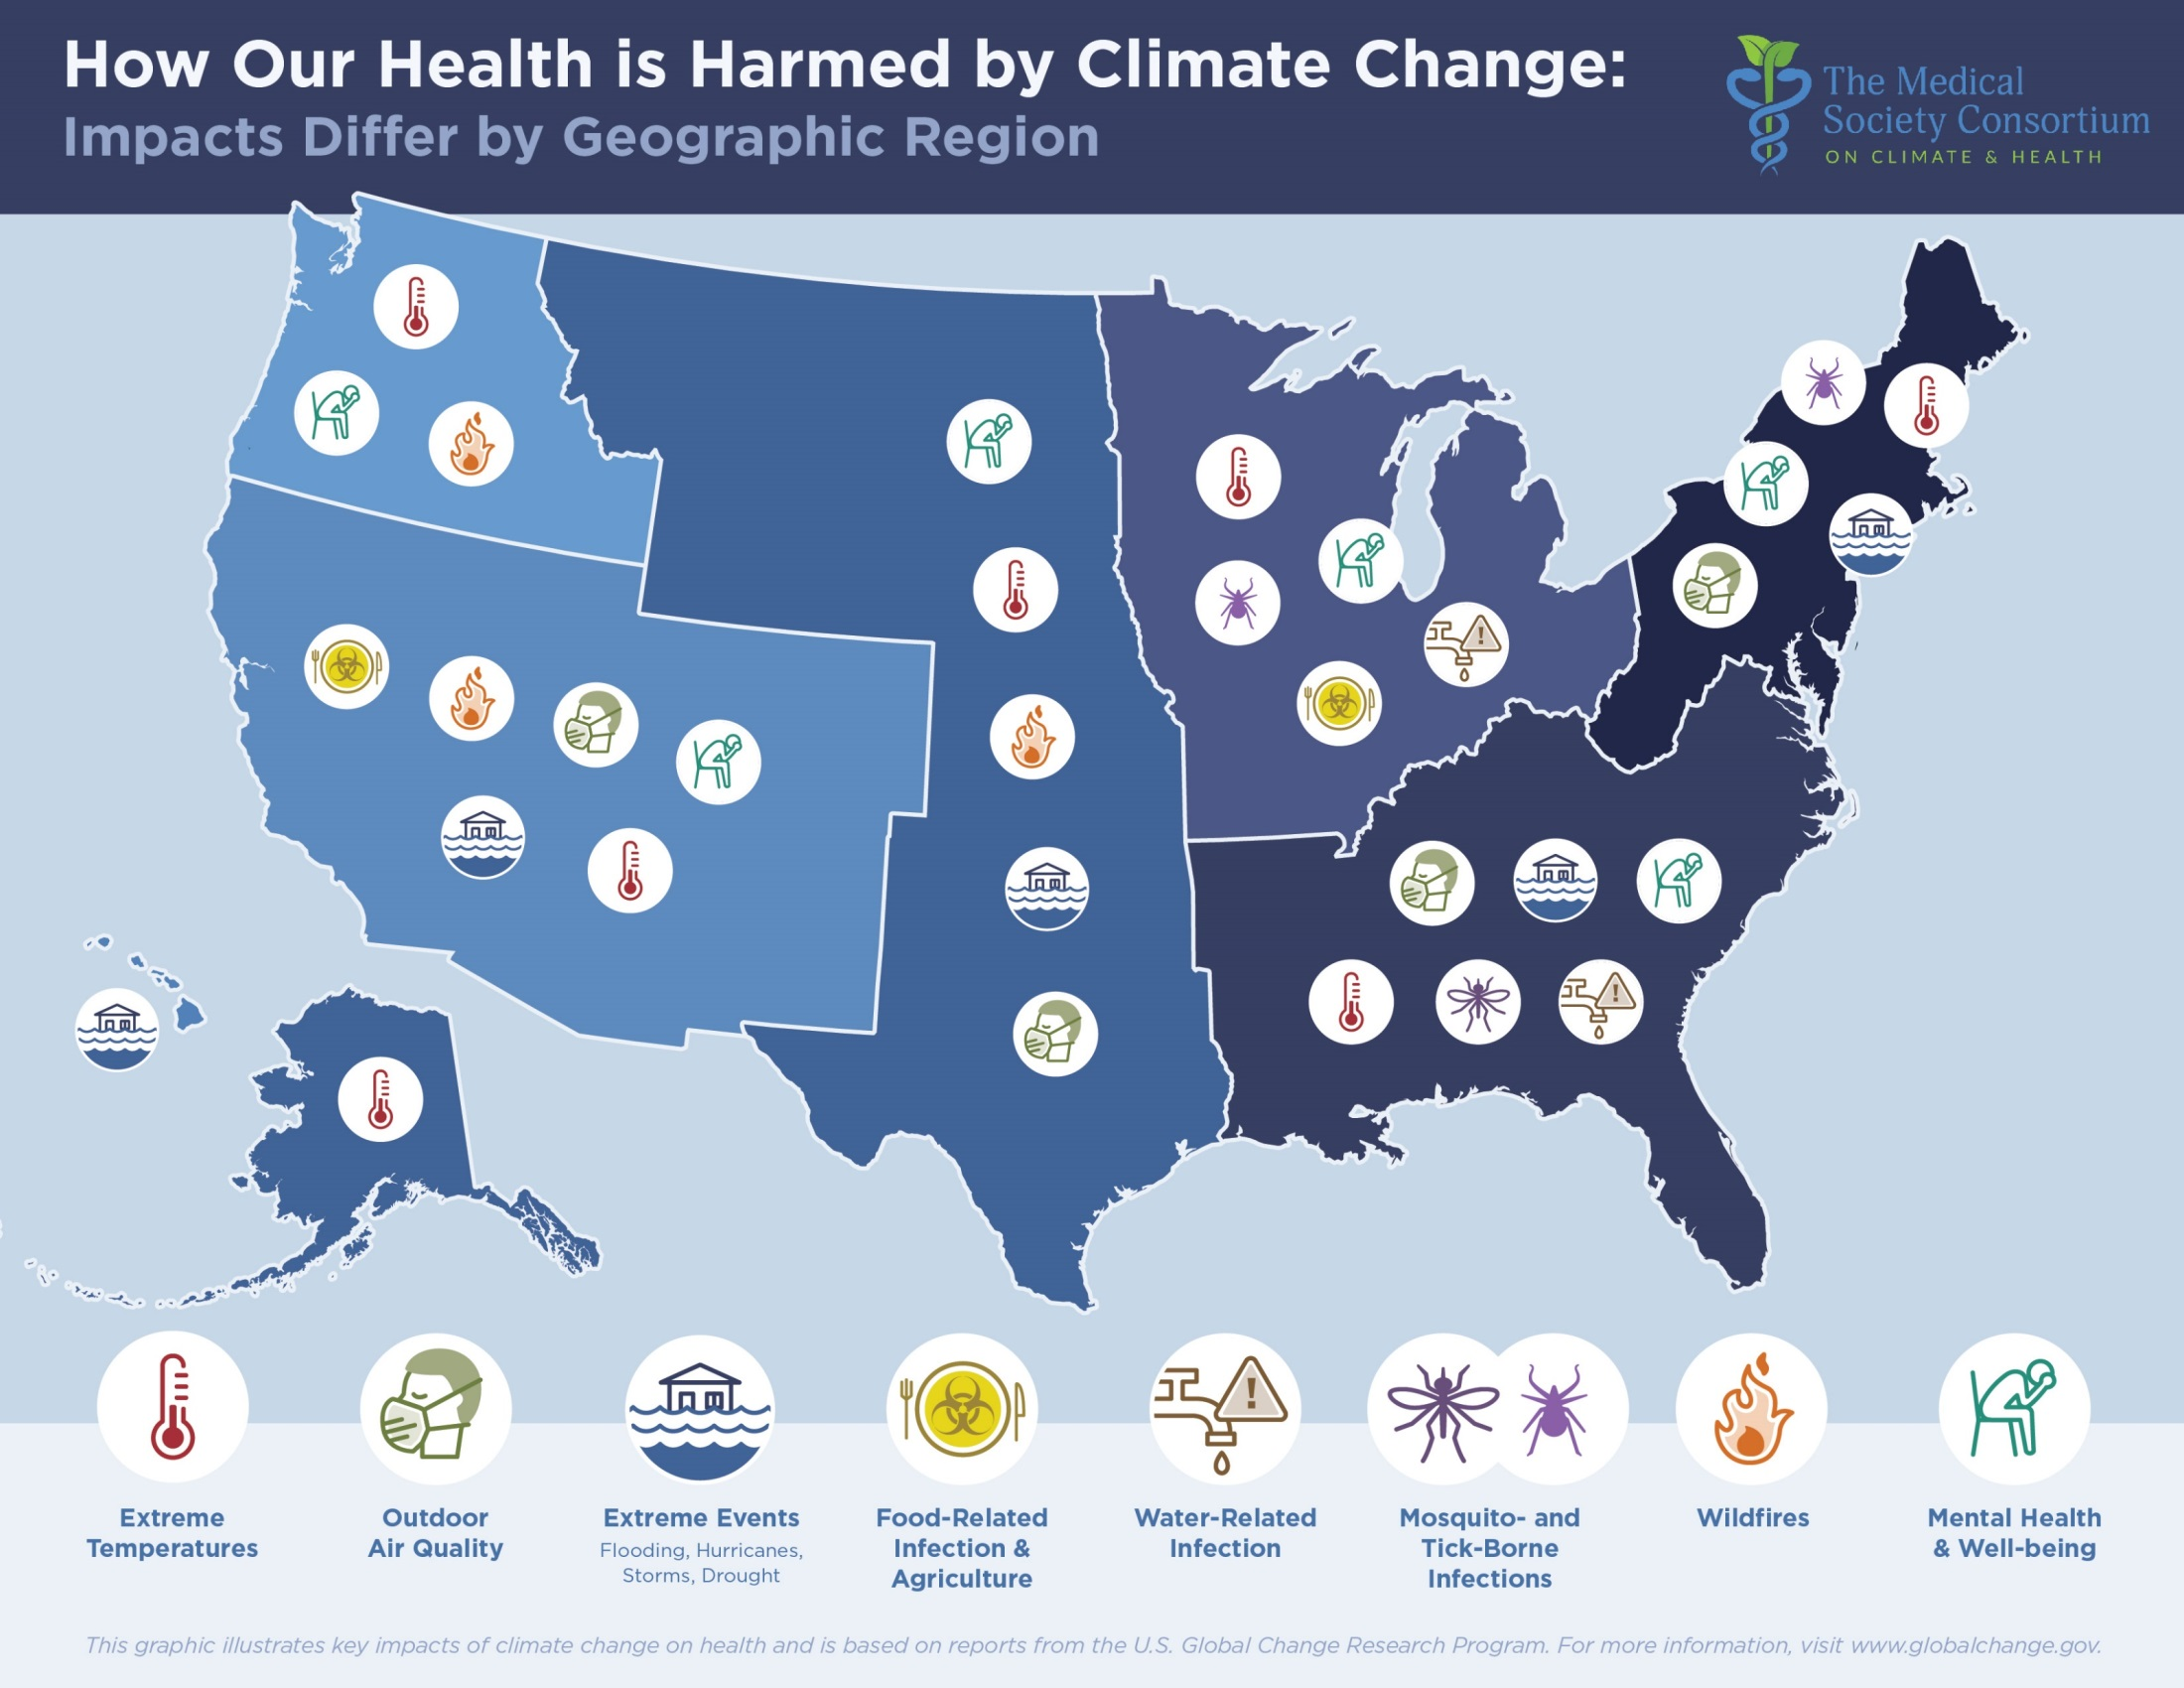

Slide 34
What We Can Do
Talk about this
Speak out for energy efficiency & clean renewable energy
Save energy; buy Energy Star appliances
Communicate support for your hospital greening efforts
Purchase renewable energy from suppliers in your area
Speak up, prevent anti-competitive laws on clean energy
Increase plant-based food choices (meat production has a big carbon footprint); buy local food that travels little
Support public transportation and reforestation
Write letters or call your legislators.

Slide 35
More Clean Renewable Energy is Available

Slide 36
Mediterranean Diets are Healthier

Slide 37
Support Low Fossil Fuel Transportation

Slide 38
Remember that Solutions Offer Health Benefits
Many chronic diseases can be prevented (primary and secondary) in ways that improve health & the environment, and stabilize the climate
Cities with more trees and cooling greenery help protect people from the heat
Diets with more vegetables and less meat are healthier
Clean energy creates less soot, less pollution, and healthier air
Active transportation (walking, biking, public transportation) is better for your health

Slide 39
Thank You
www.medsocietiesforclimatehealth.org
Facebook: Medical Society Consortium
Twitter: @docsforclimate
#climateandhealth

